Slide 1
Irrigation Scheduling using the Checkbook Method
Matt Fischer
Pope SWCD

Slide 2
Why Use Irrigation Scheduling?
Know when to apply because rainfall is inadequate to meet crop evapotranspiration (ET) and crop is open to significant plant moisture stress
Know how much to apply so you only use enough water so as to reduce the risk of deep percolation below the root zone and leaching of some nitrogen into the groundwater
Conserve water, save money, and boost yields

Slide 3
Evapotranspiration
“ ET “
Rain and Irrigation
Root Depth – Soil in this
area holds the water and
nutrients for the plant
Excess Water Causes
Nitrate N Leaching

Slide 4
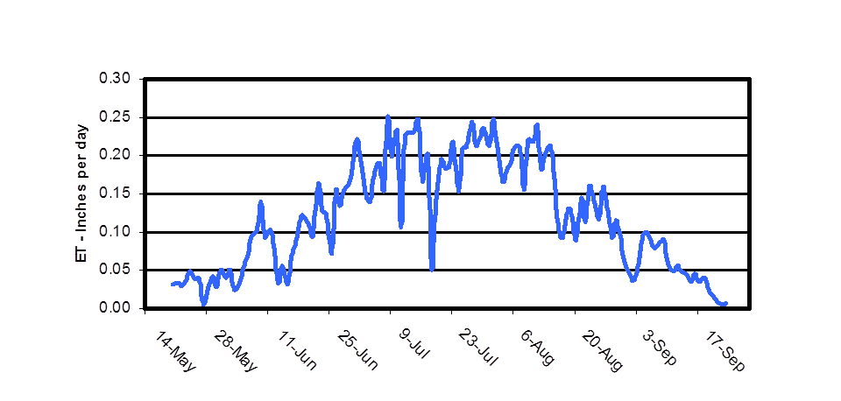
Estimated Daily Crop Water Use “ET” Typical Annual Crop

Slide 5
The Basics to Getting Started
Crop – Plant date and Emergence Date
Soil
Maximum Daily Temperature
Rain and Irrigation amounts – 2 rain gauges
Keep Good Records
In-field Soil Moisture Checks

Slide 6
Soils
Web Soil Survey
http://websoilsurvey.nrcs.usda.gov/app/WebSoilSurvey.aspx

Slide 7
Soils
Find field and delineate Area of Interest

Slide 9
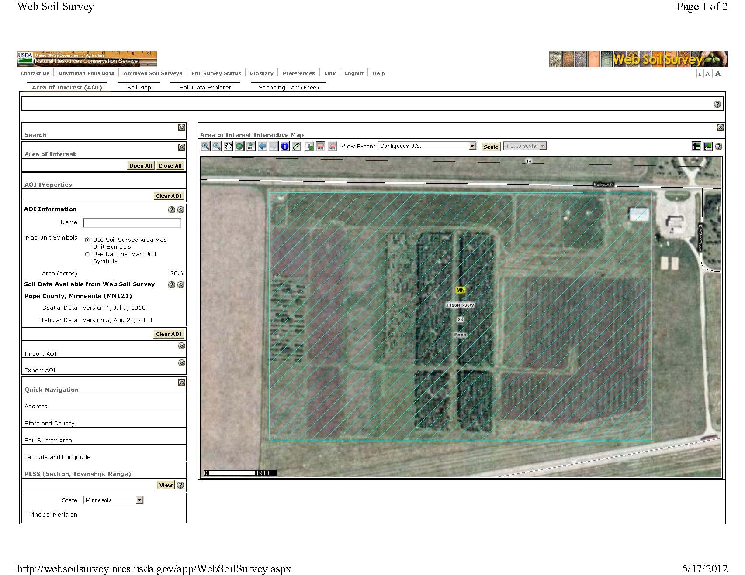

Slide 10
Soils
Find field and delineate Area of Interest
Determine field’s most limiting soil for available water capacity (20% of Field)
Soil Data Explorer -> Soil Properties and Qualities -> Soil Physical Properties -> Available Water Capacity
Top Depth = 0, Bottom Depth = ? (36), Make sure to click on Inches, Click View Rating

Slide 11
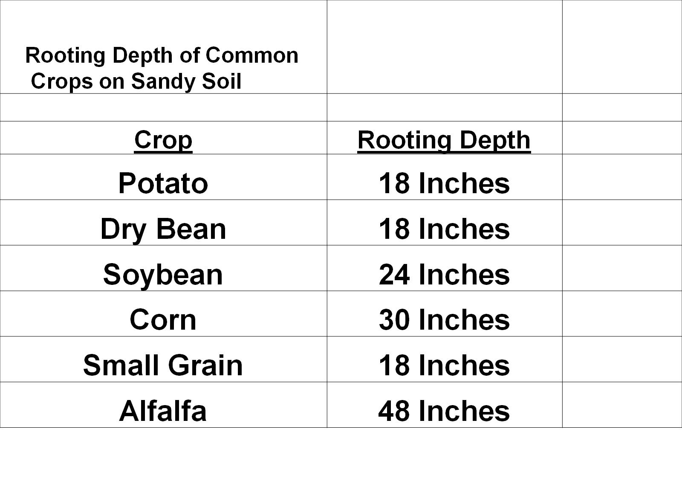

Slide 12
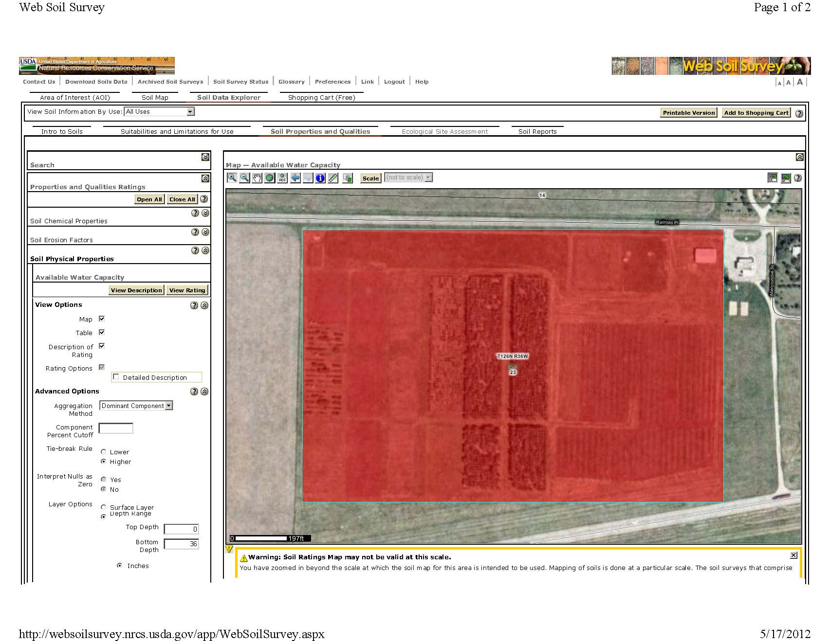

Slide 13
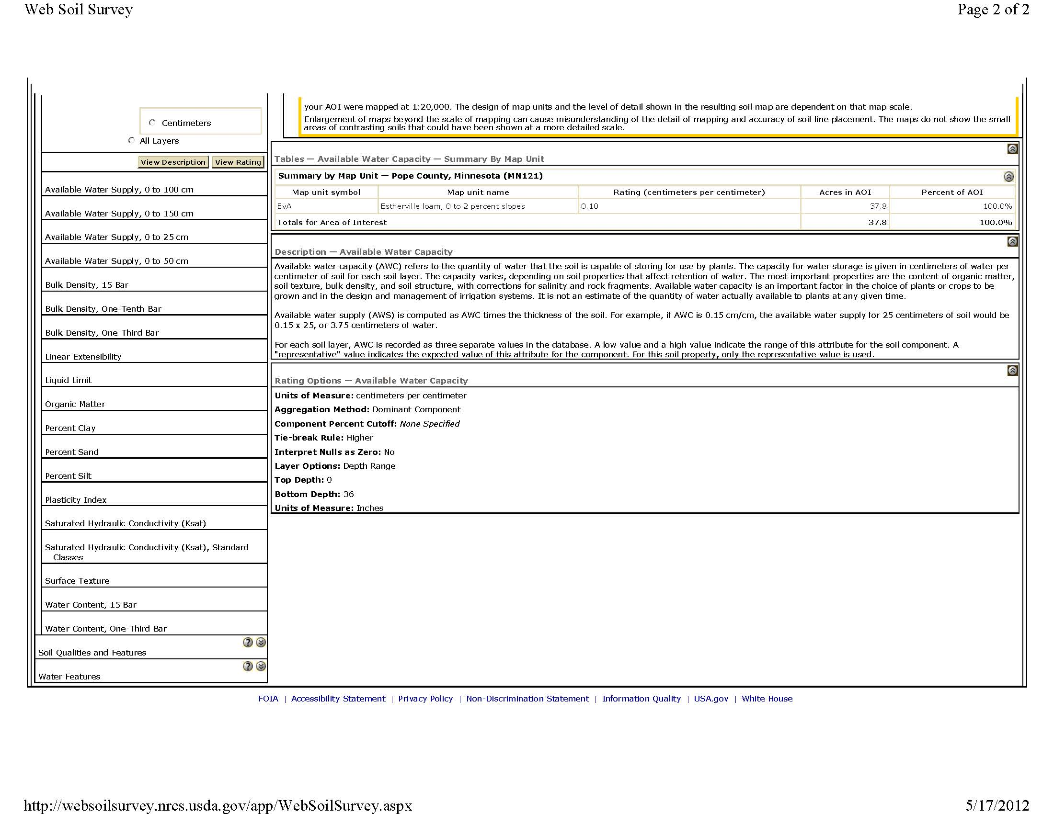

Slide 14
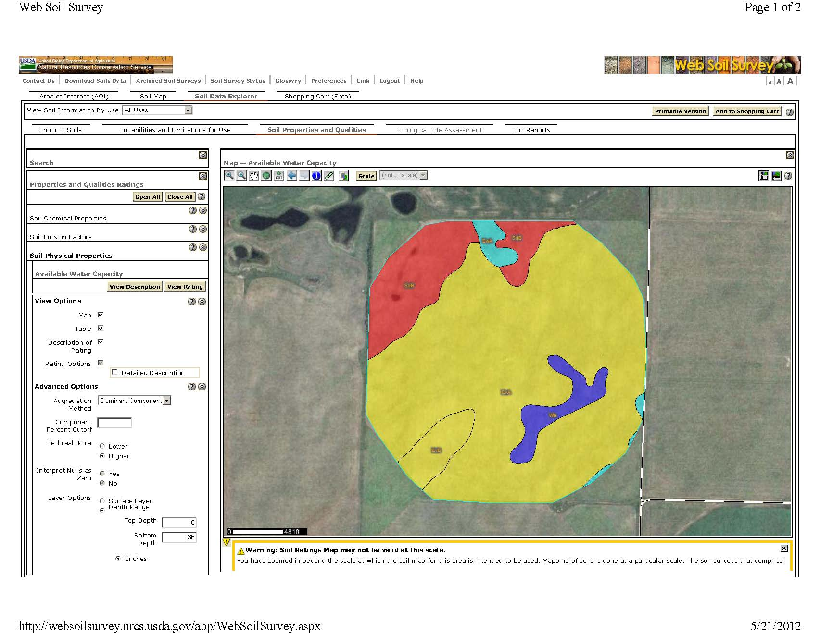

Slide 15
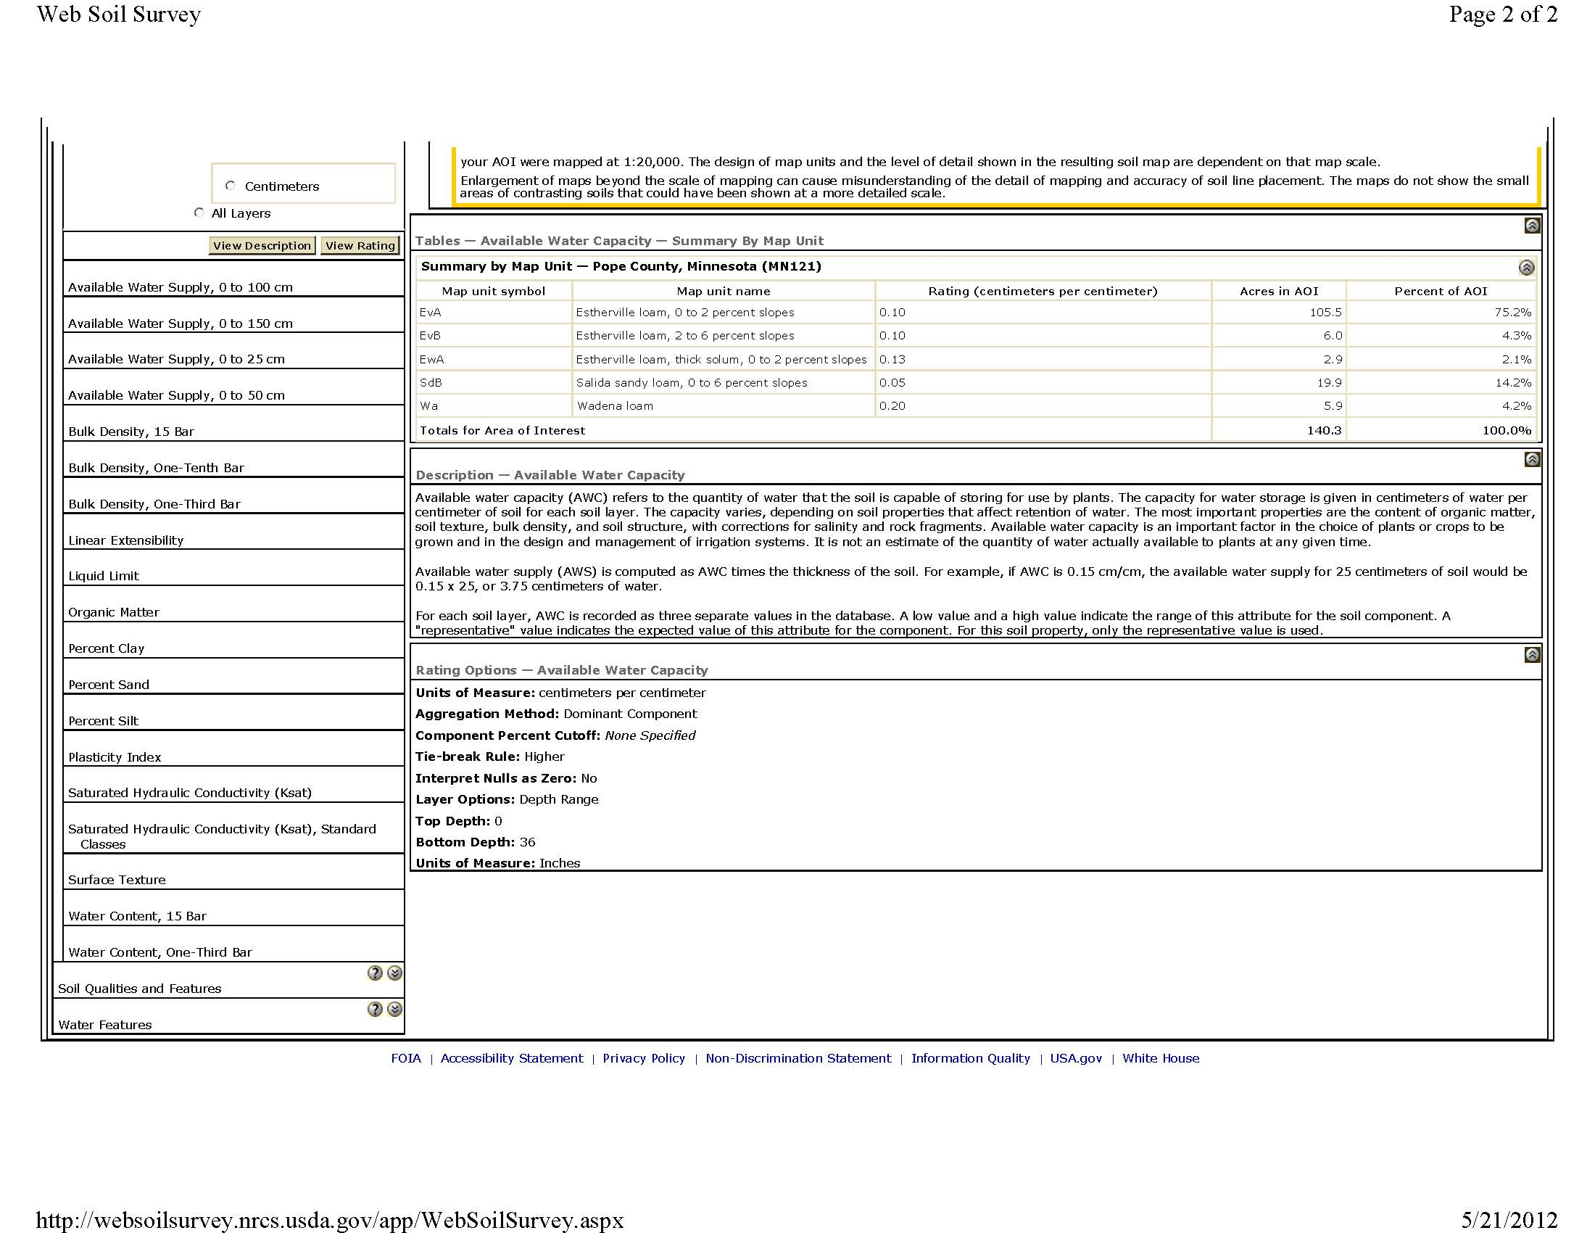

Slide 16
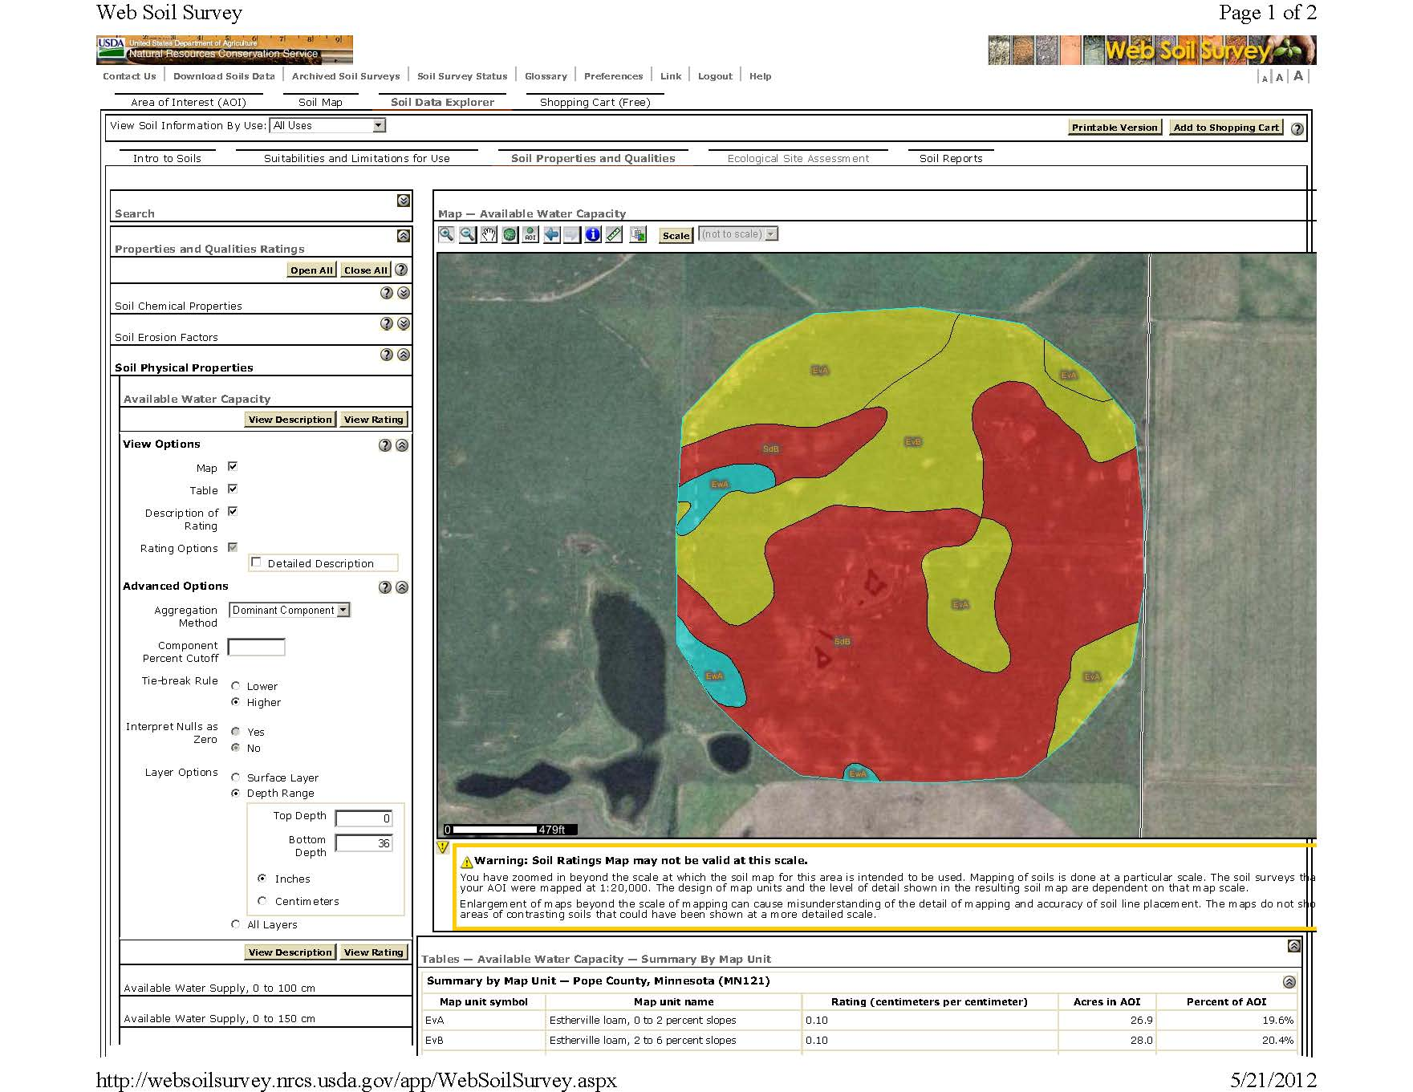

Slide 17
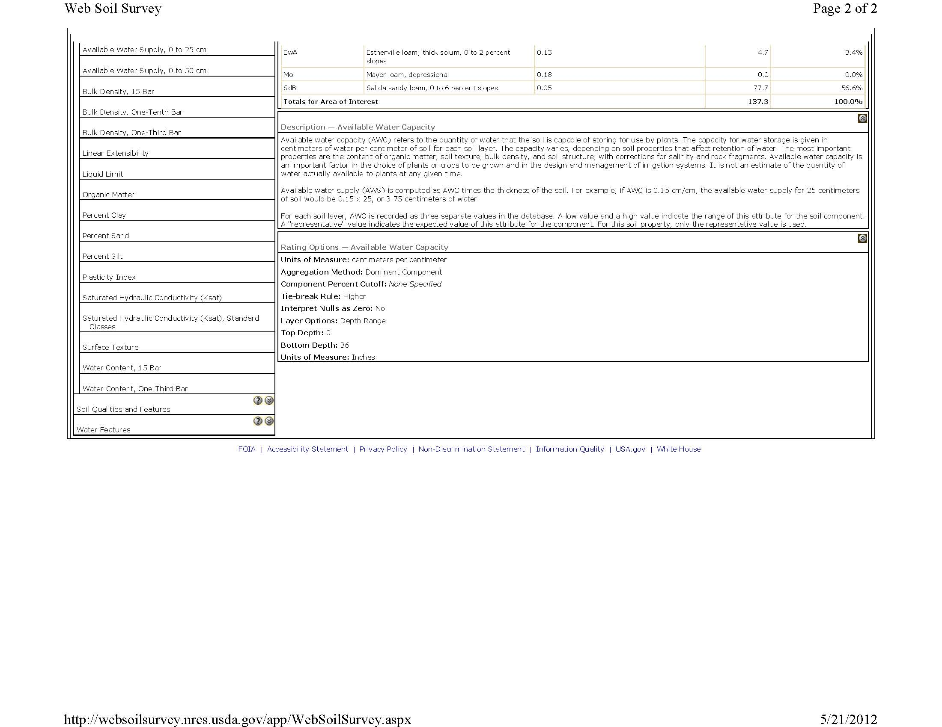

Slide 18
Soils
Find field and delineate Area of Interest
Determine field’s most limiting soil for available water capacity (20% of Field)
Soil Data Explorer -> Soil Properties and Qualities -> Soil Physical Properties -> Available Water Capacity
Top Depth = 0, Bottom Depth = ? (36), Make sure to click on Inches, Click View Rating
Determine that soil’s Available Water Capacity
Soil Map -> Choose Most Limiting Soil
Also look at Physical Soil Properties Table (Found on CD)

Slide 19
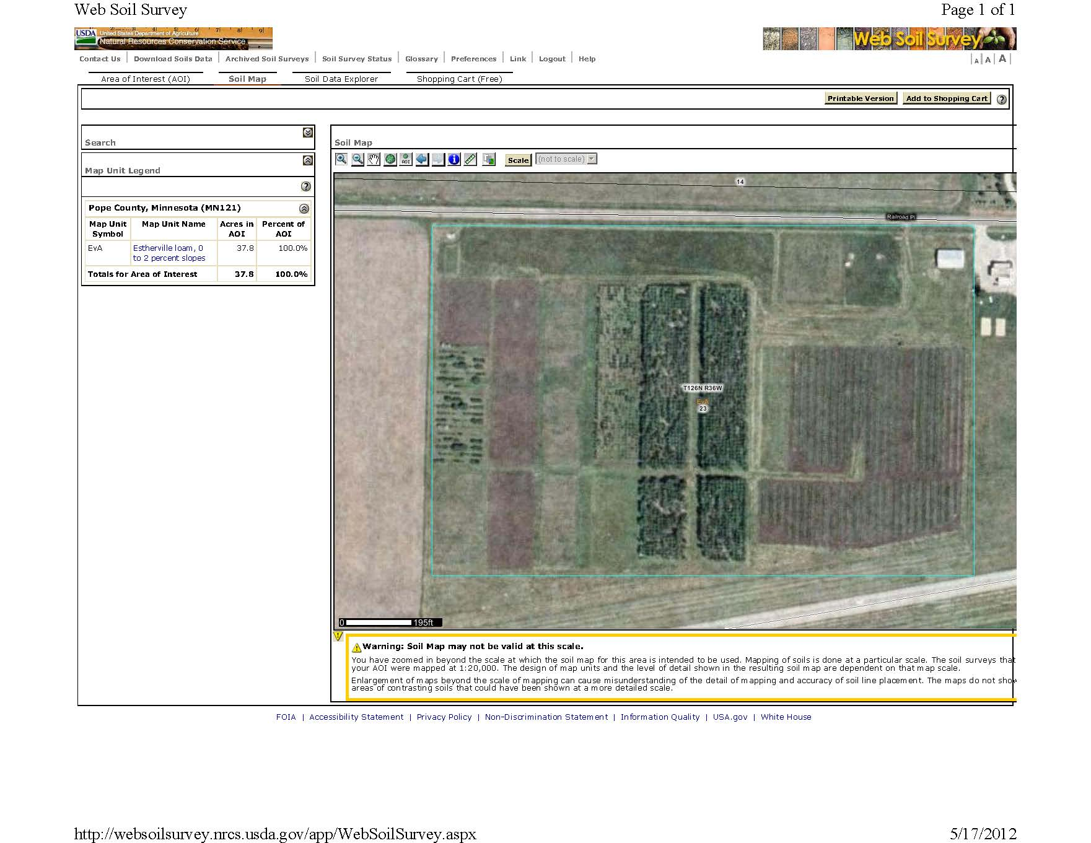

Slide 20
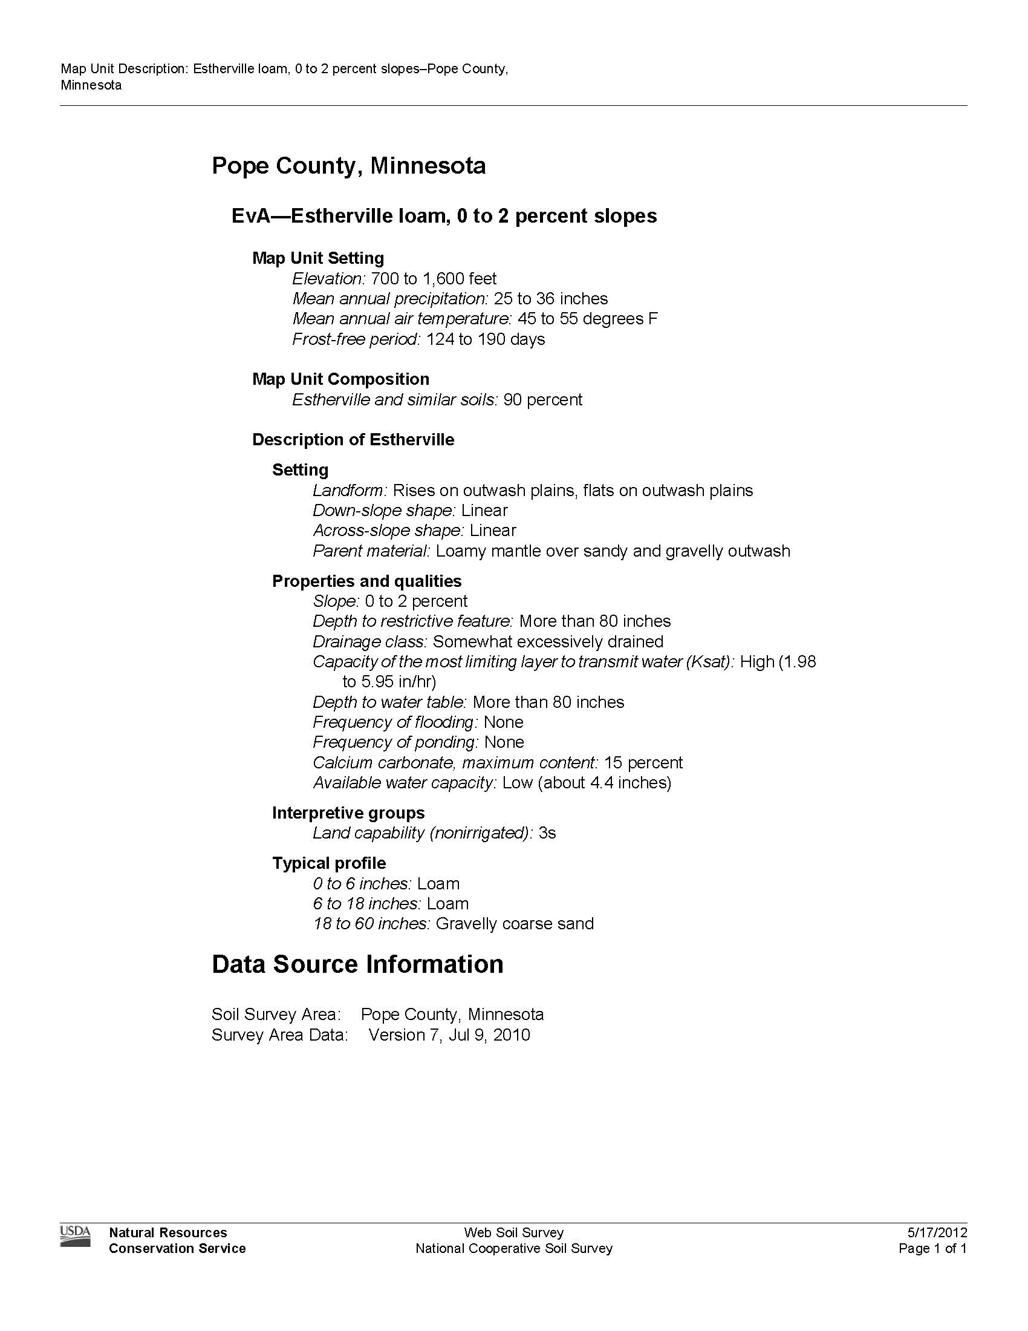

Slide 21
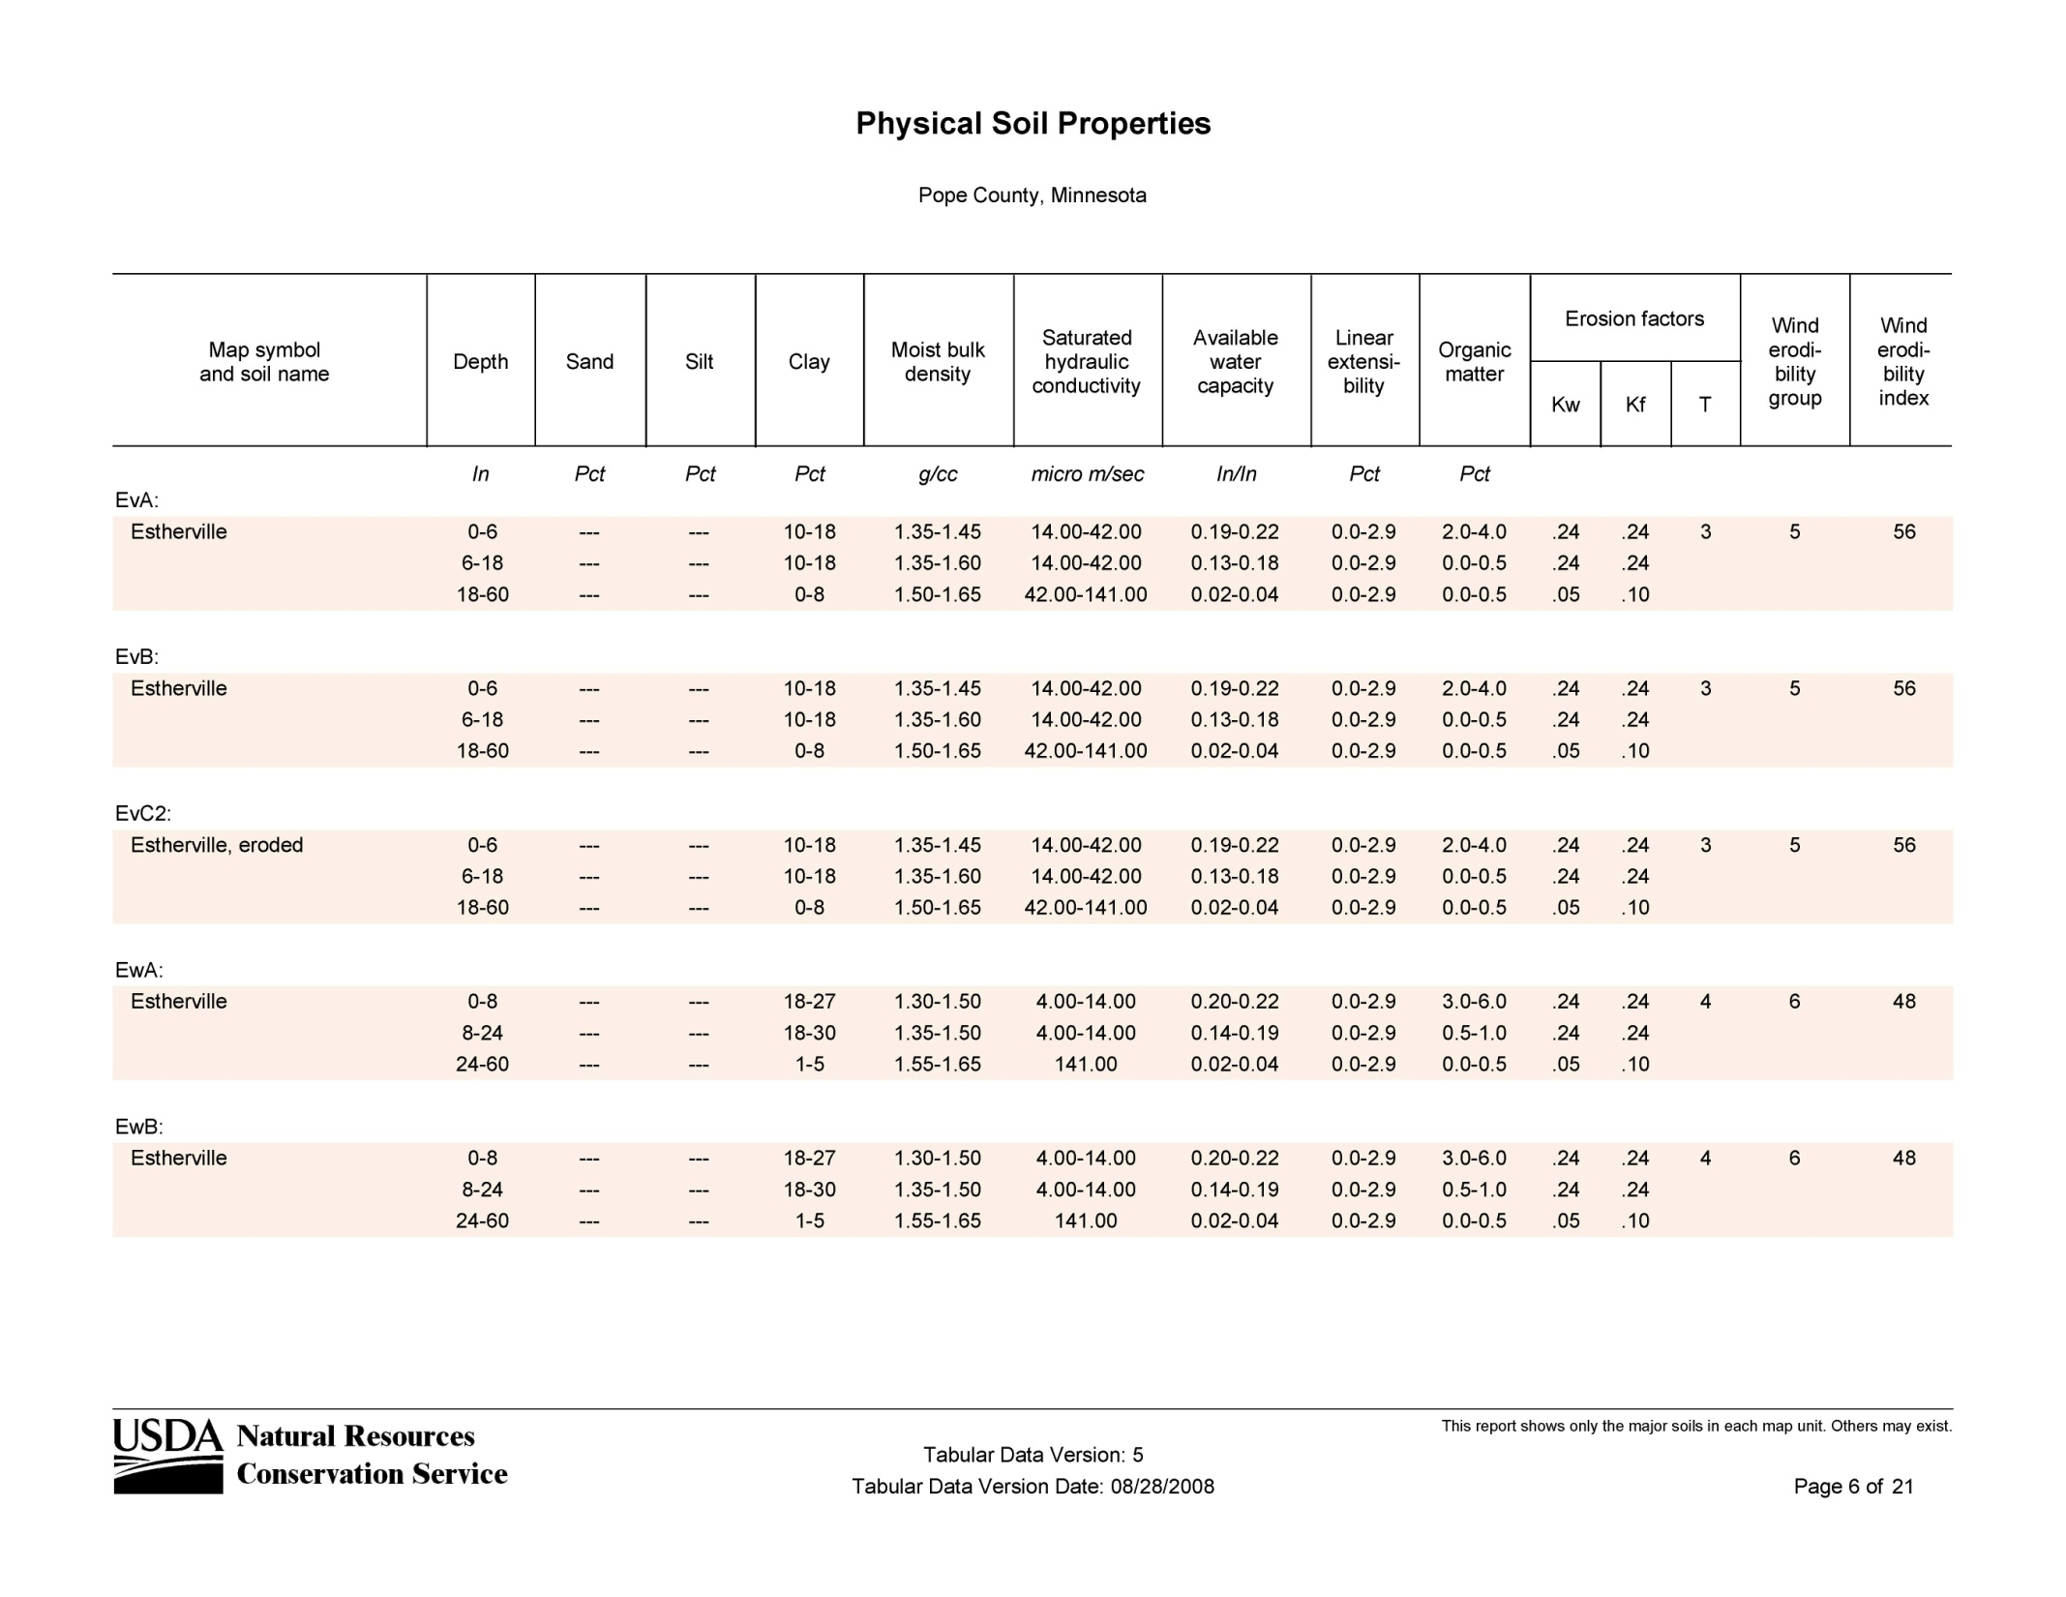

Slide 22
Available Water Capacity
Estherville loam, 0 to 2 percent slopes (EvA)
0-6 inches – Loam – .205 in/in AWC
6-18 inches – Loam – .155 in/in AWC
18-36 inches – Gravelly Coarse Sand – .03 in/in AWC
(6*.205)+(12*.155)+(18*.03) = 3.63 in/in

Slide 23
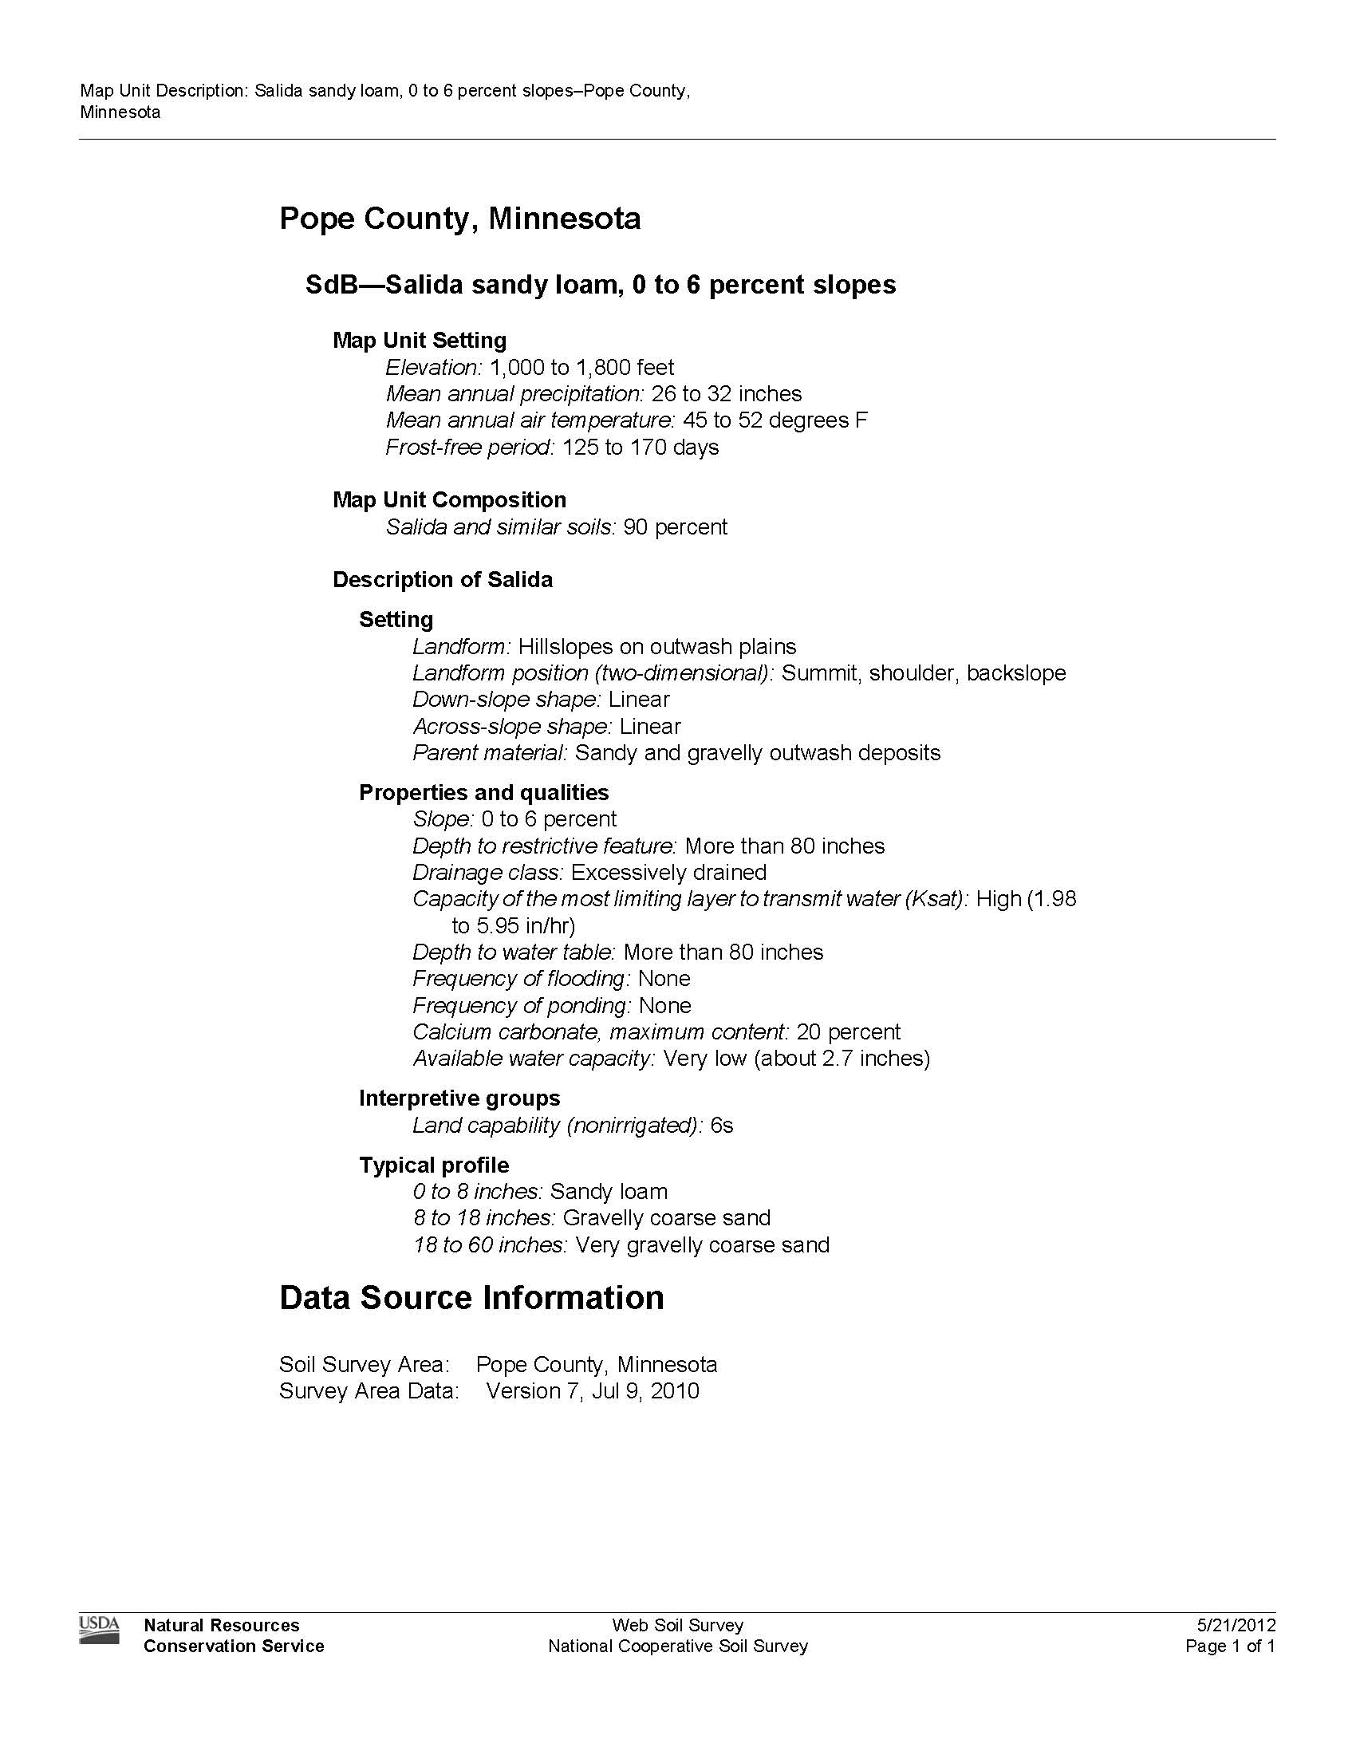

Slide 24
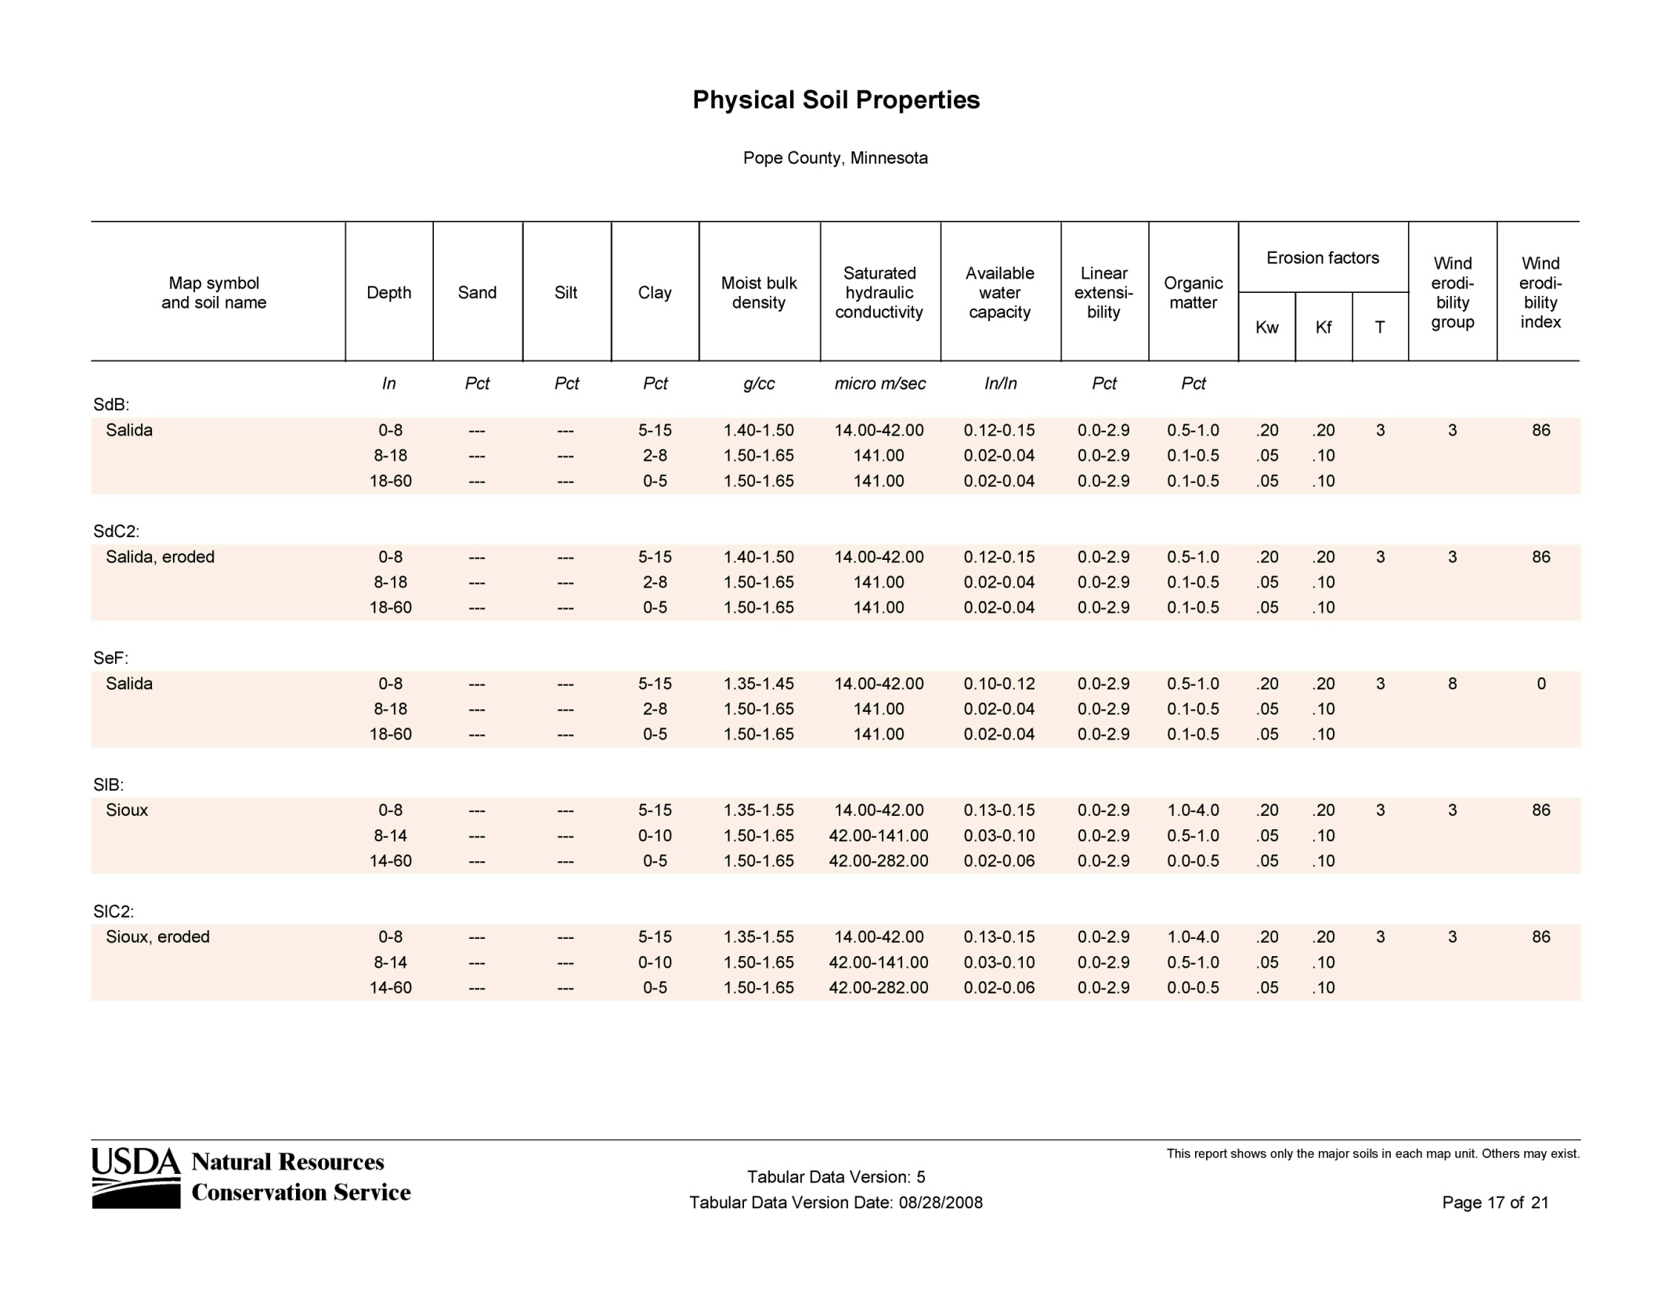

Slide 25
Available Water Capacity
Salida sandy loam, 0 to 6 percent slopes (SdB)
0-8 inches – Sandy loam – .135 in/in AWC
8-18 inches – Gravelly Coarse Sand – .03 in/in AWC
18-36 inches – Very gravelly Coarse Sand – .03 in/in AWC
(8*.135)+(10*.03)+(18*.03) = 1.92 in/in

Slide 26
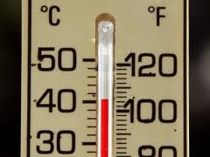
Weather Data
State Climatology Office
http://climate.umn.edu/HIDradius/radius.asp
Rosholt Weather Station
http://www.popeswcd.org/weatherstation/

Slide 27
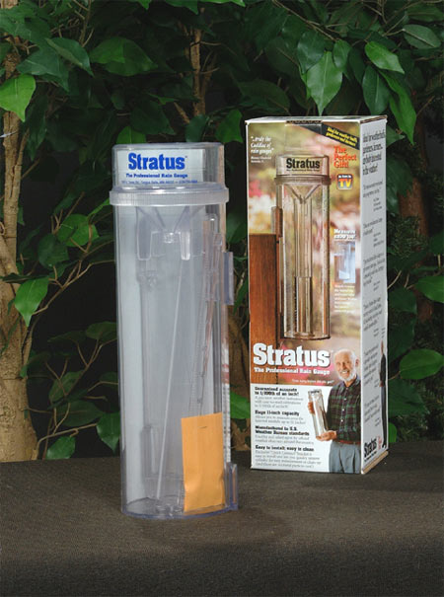
Rainfall & Irrigation
On-site data is best
2 rain gauges – 1 under irrigator, 1 away from the irrigator
Keep Good Records

Slide 28
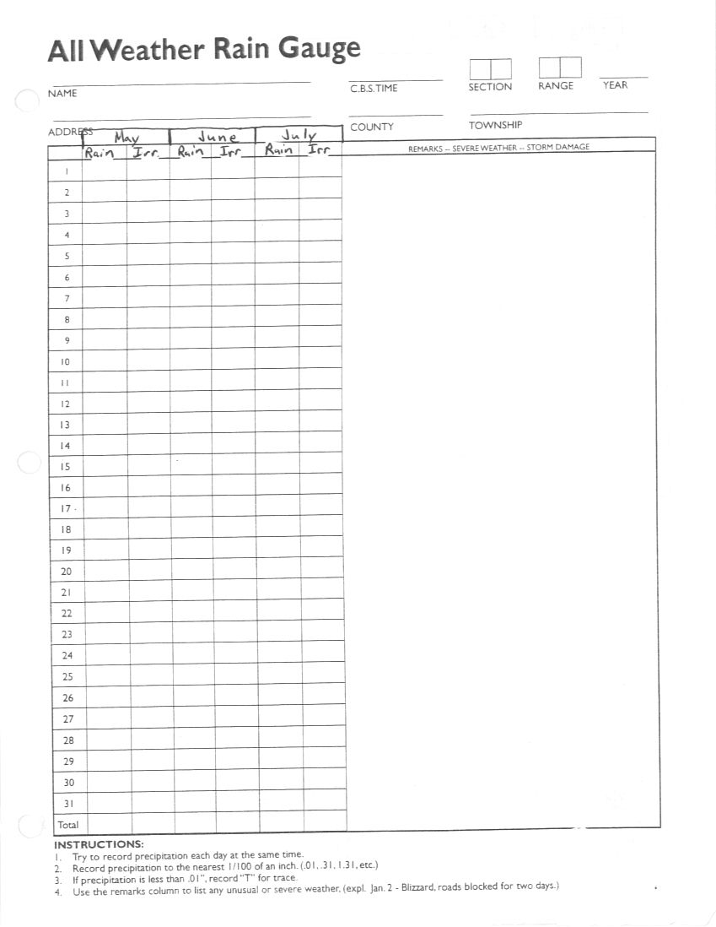

Slide 29
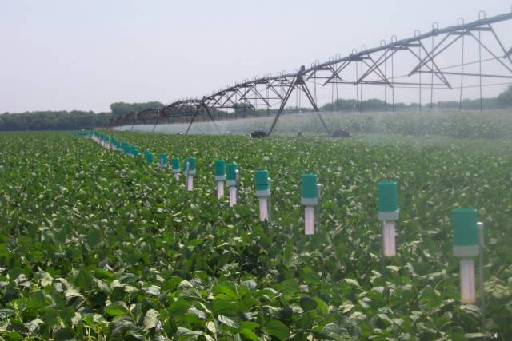
2 or more Rain Gauges

Slide 30
Climatology Data Retrieval
Set Location
Select what information you want
Temperature
Precipitation if you missed any
Click on Get Daily

Slide 31
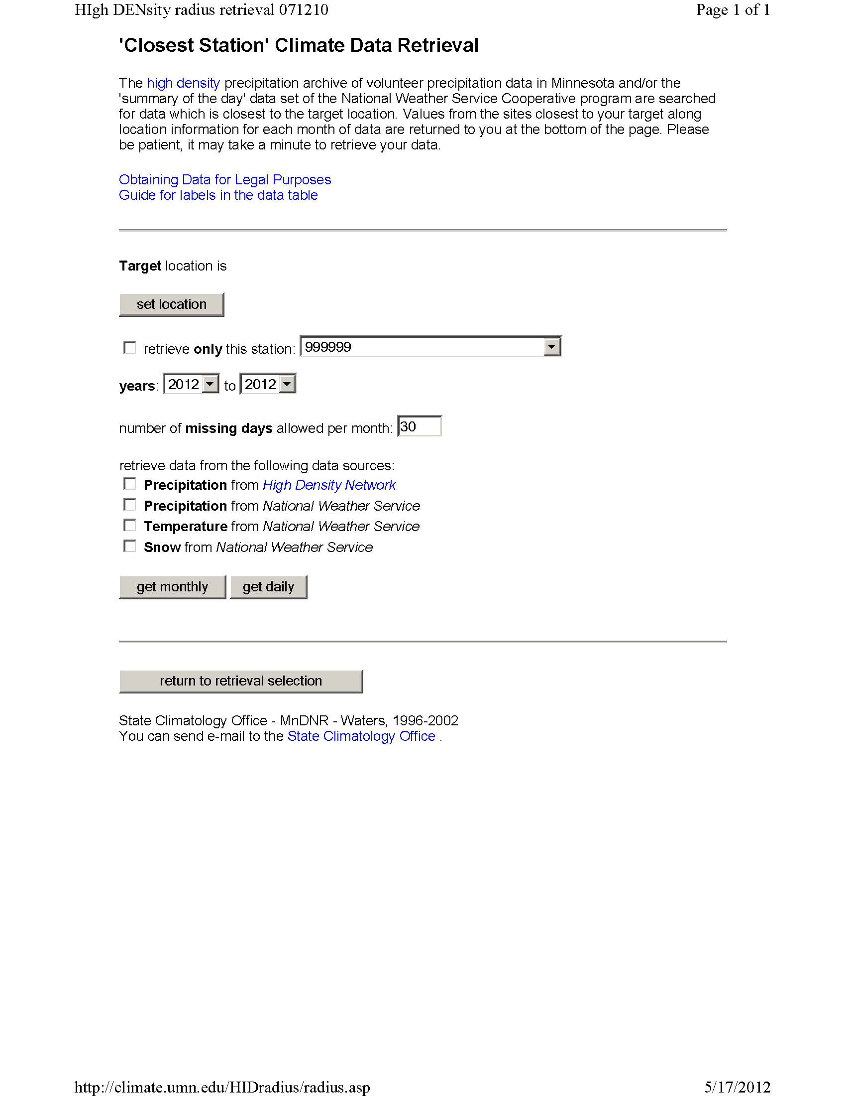

Slide 32
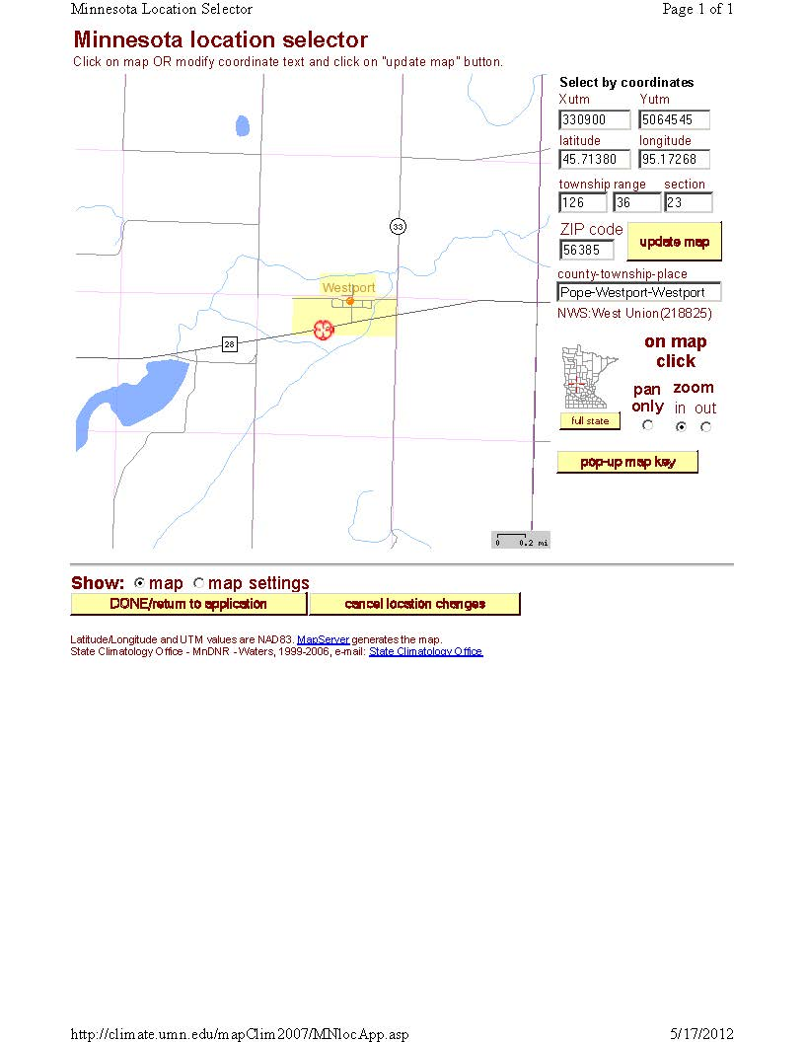

Slide 33
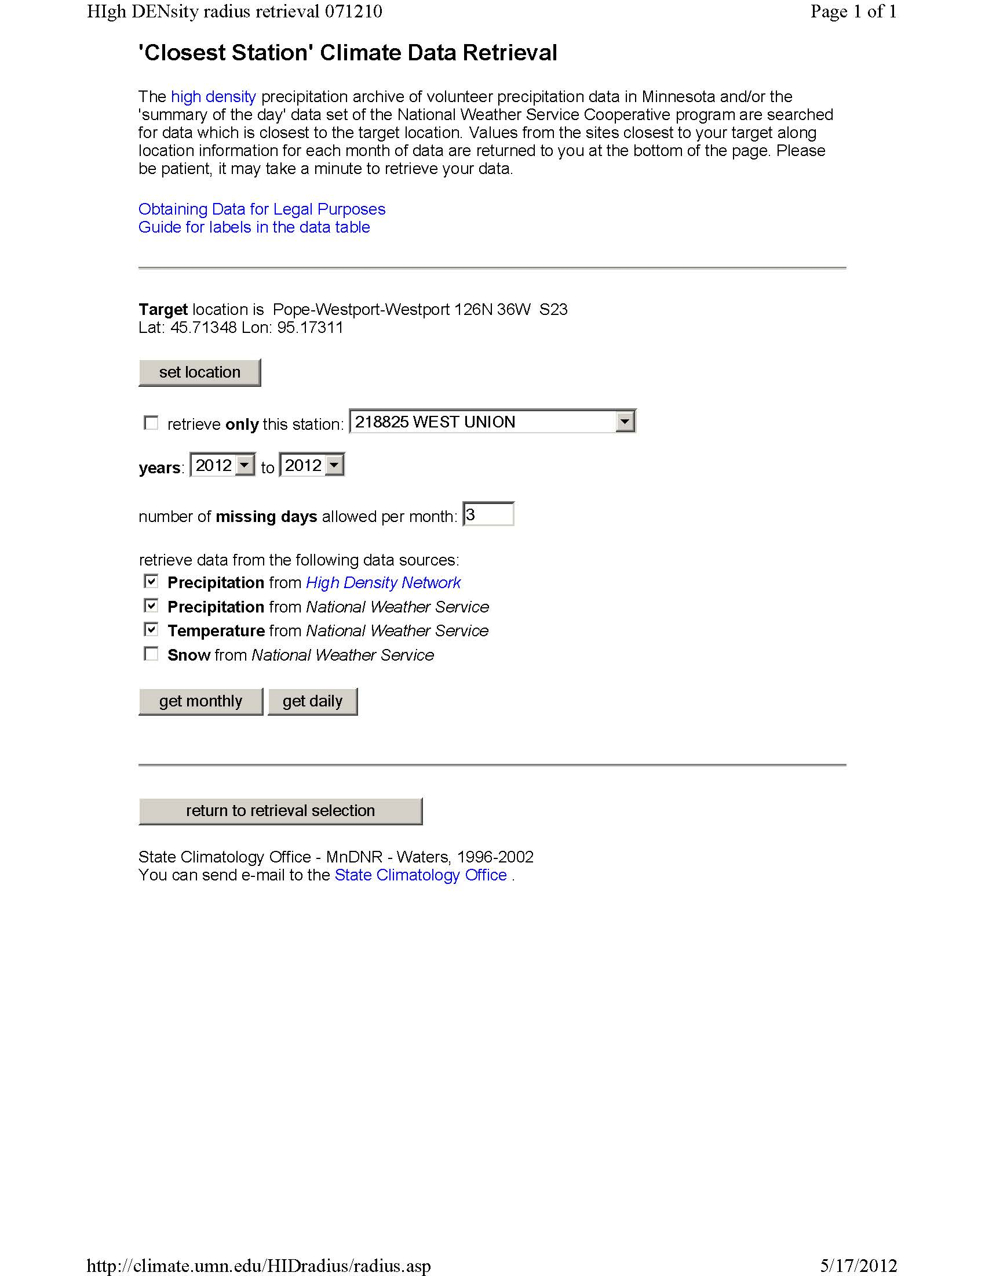

Slide 34
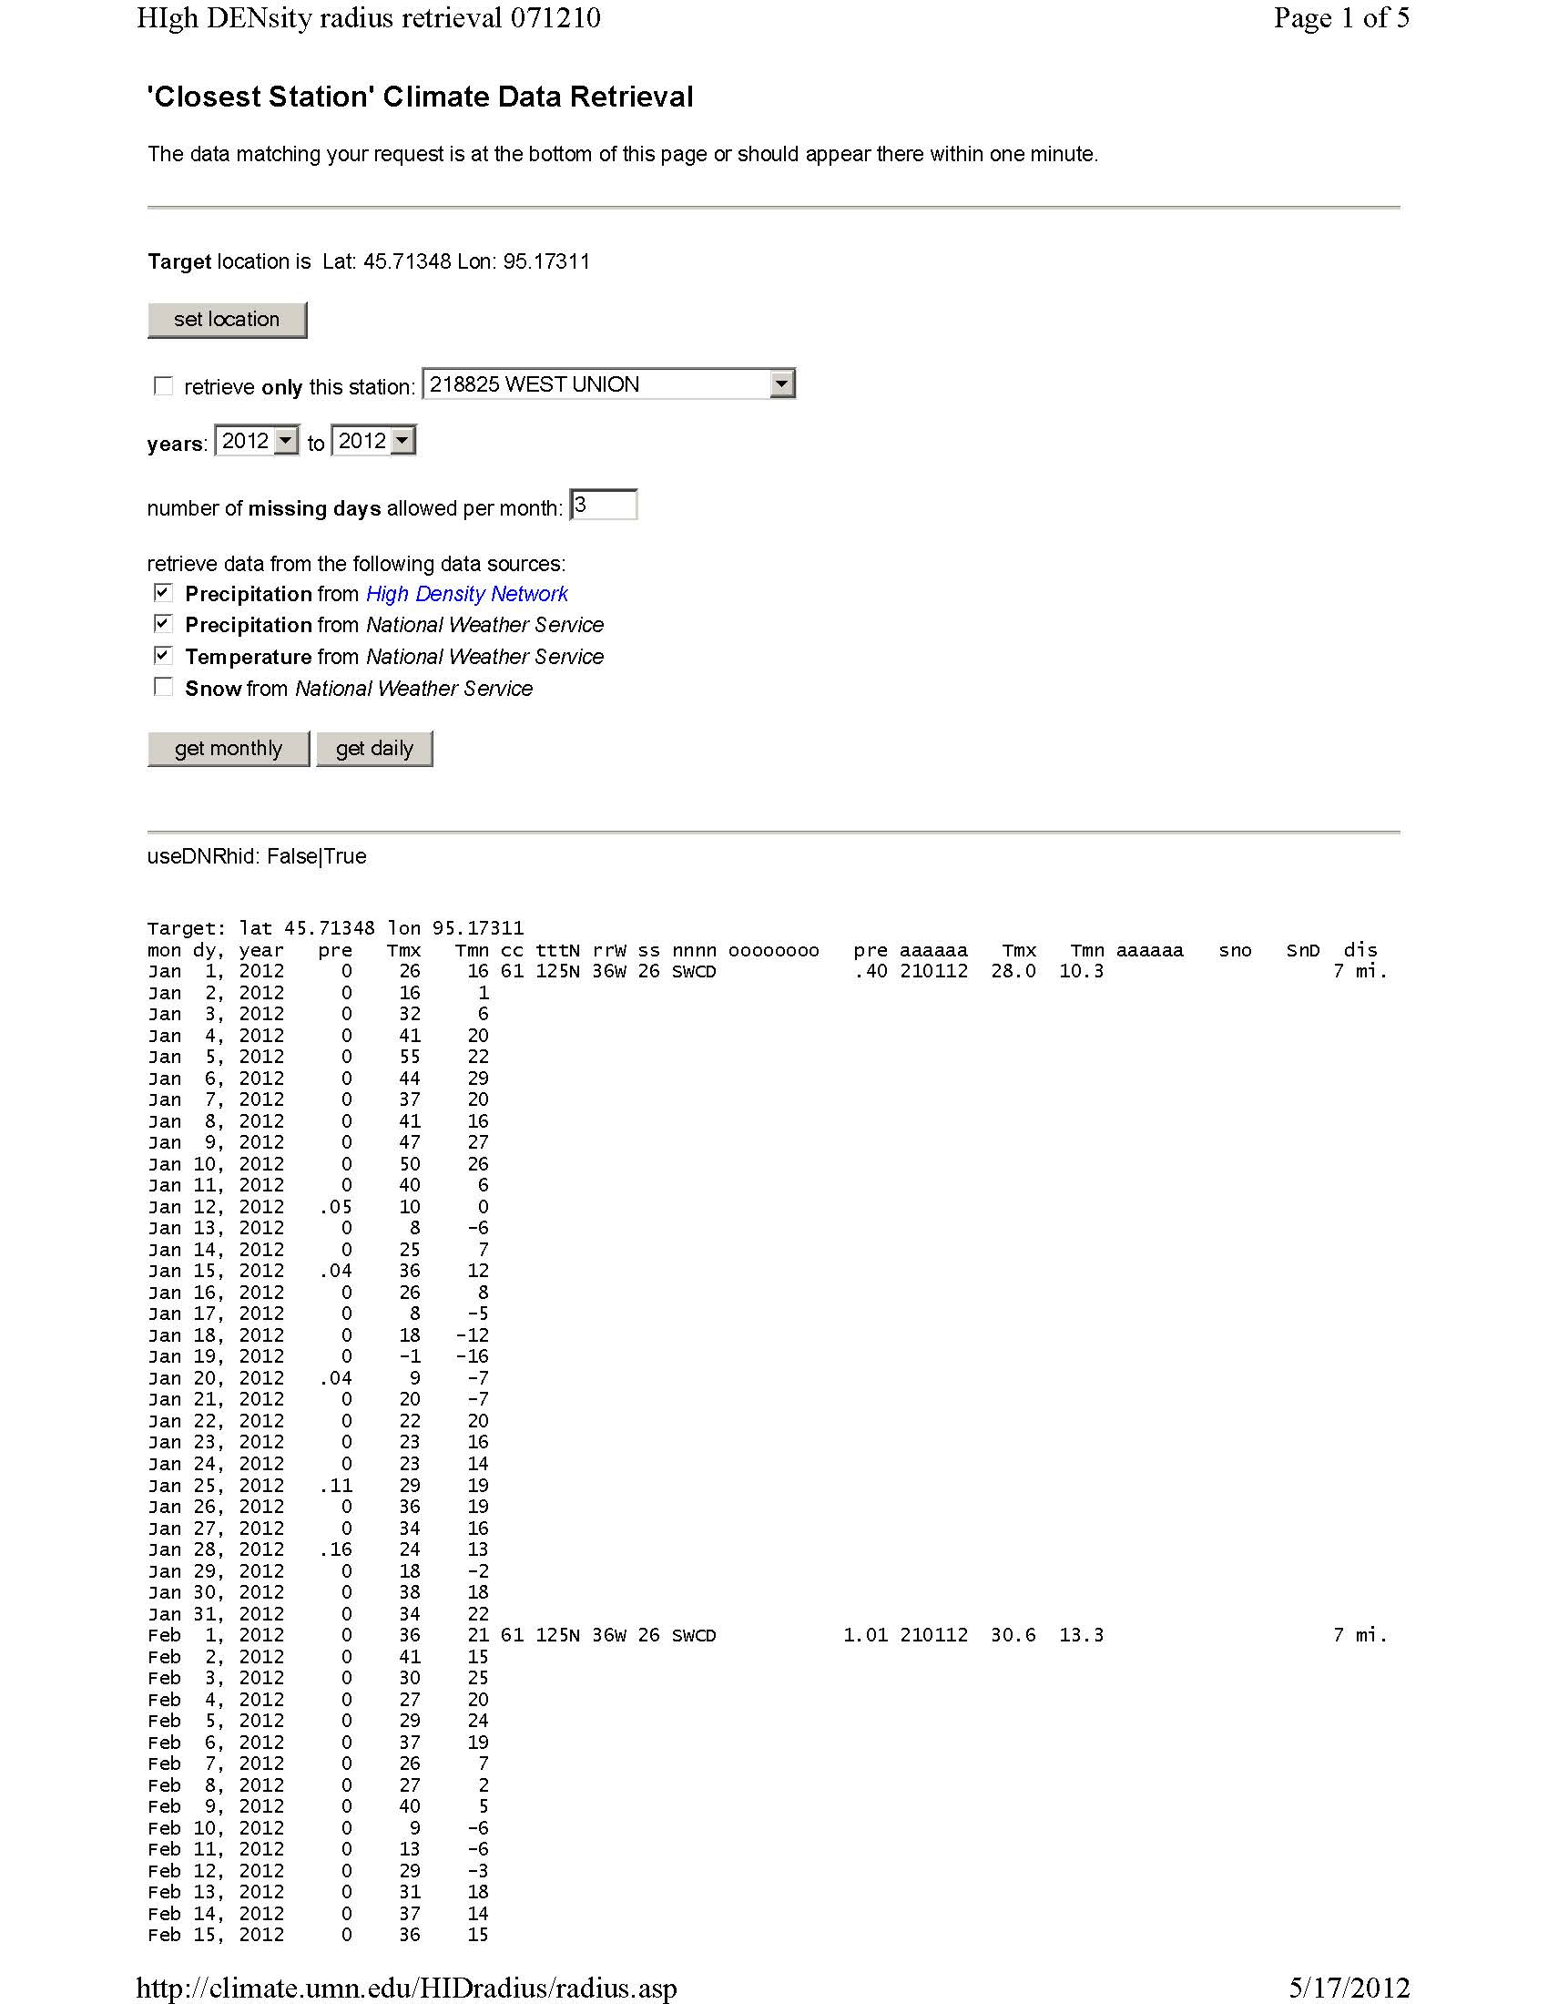

Slide 35
Rosholt Weather Station
If field is close to Westport, you can use data from the Rosholt Weather Station
Temperature and rainfall
Compare ET
More information if you are interested

Slide 36
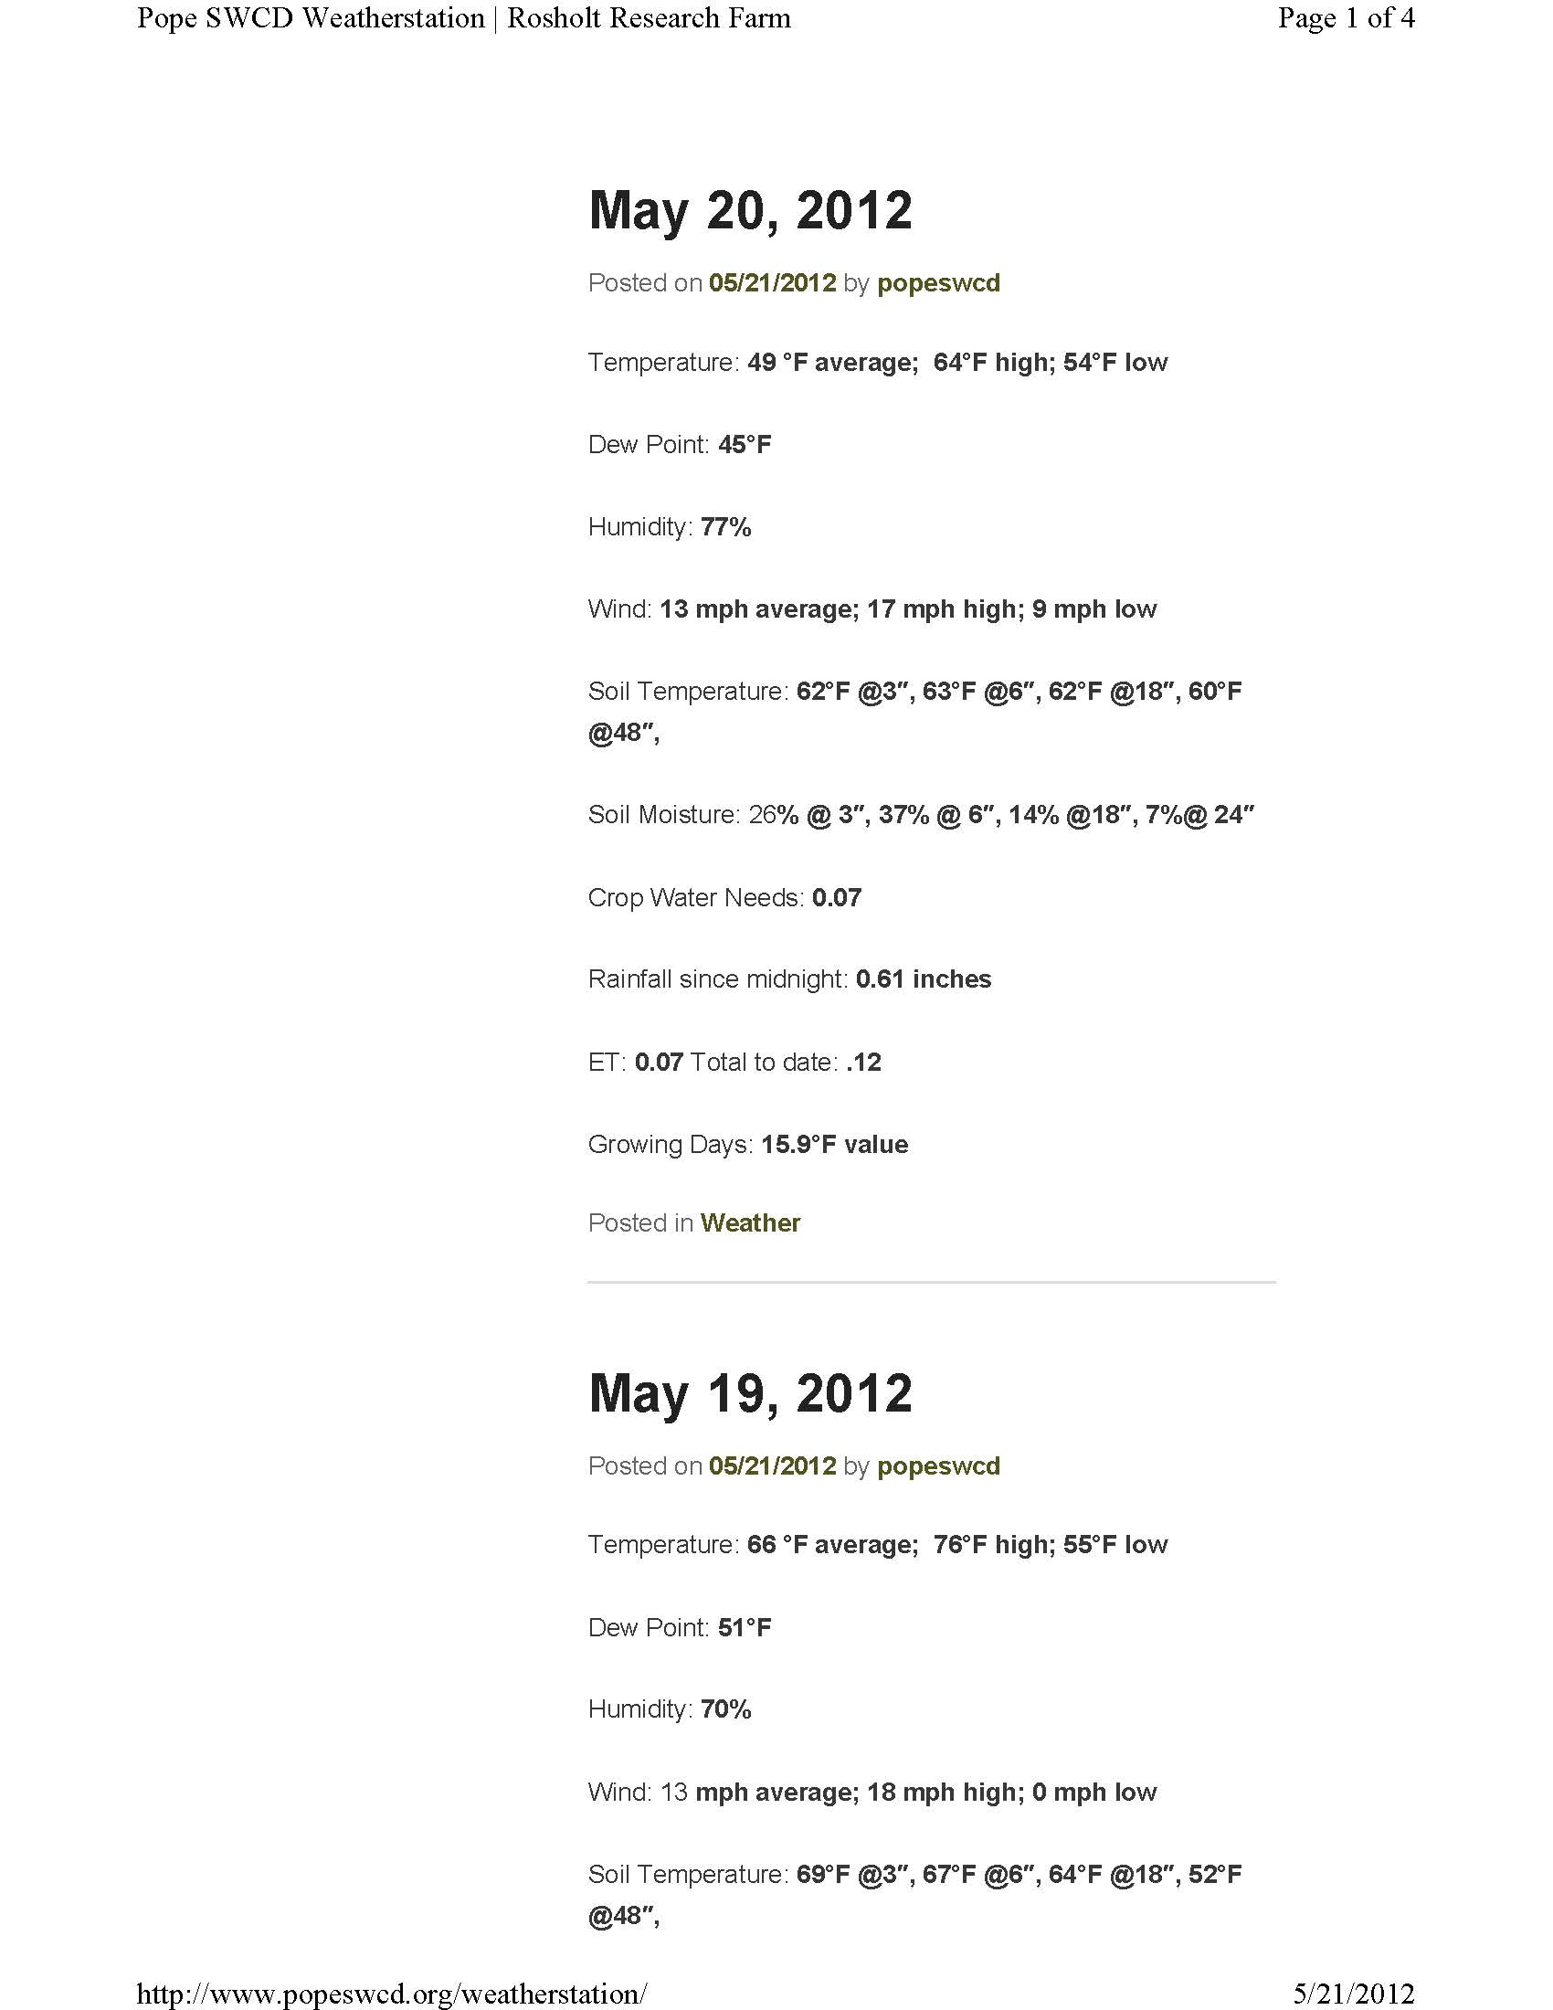

Slide 37
Estimated ET Potentials
http://www.soils.wisc.edu/uwex.agwx/sun_water

Slide 38
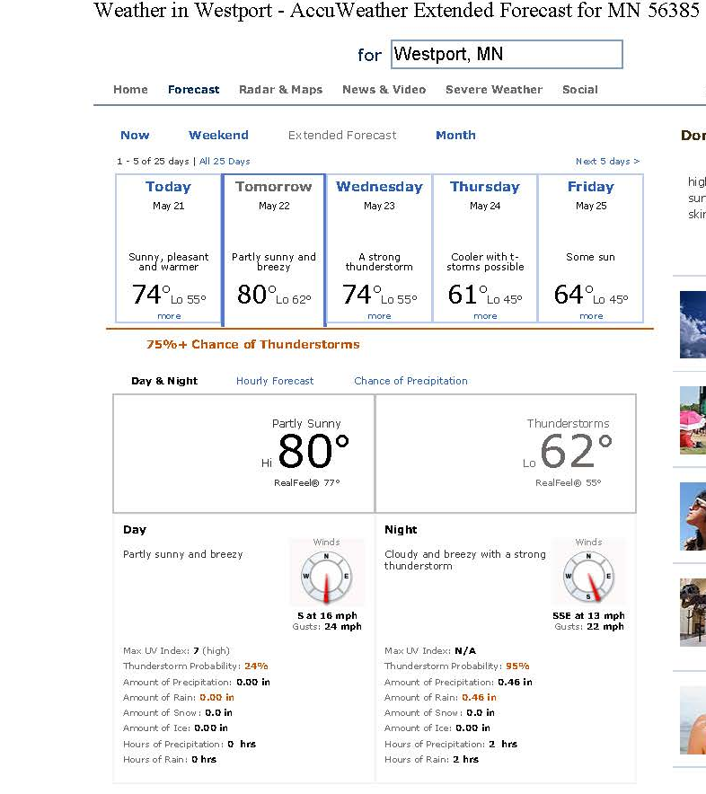
Favorite Weather Site or News
Wherever you get your forecast from and trust the most

Slide 39
Irrigation Scheduling Worksheet
Fill in Field Indicator, Crop, & Emergence Date
Click on Crops & Soils
You will have to scroll right and down a bit
Can adjust root zone maximum depth and week of root zone maximum depth
Can also adjust management allowed depletion
Need to adjust soils to your most limiting soil’s available water capacity
Click on Return to Cell B8

Slide 40
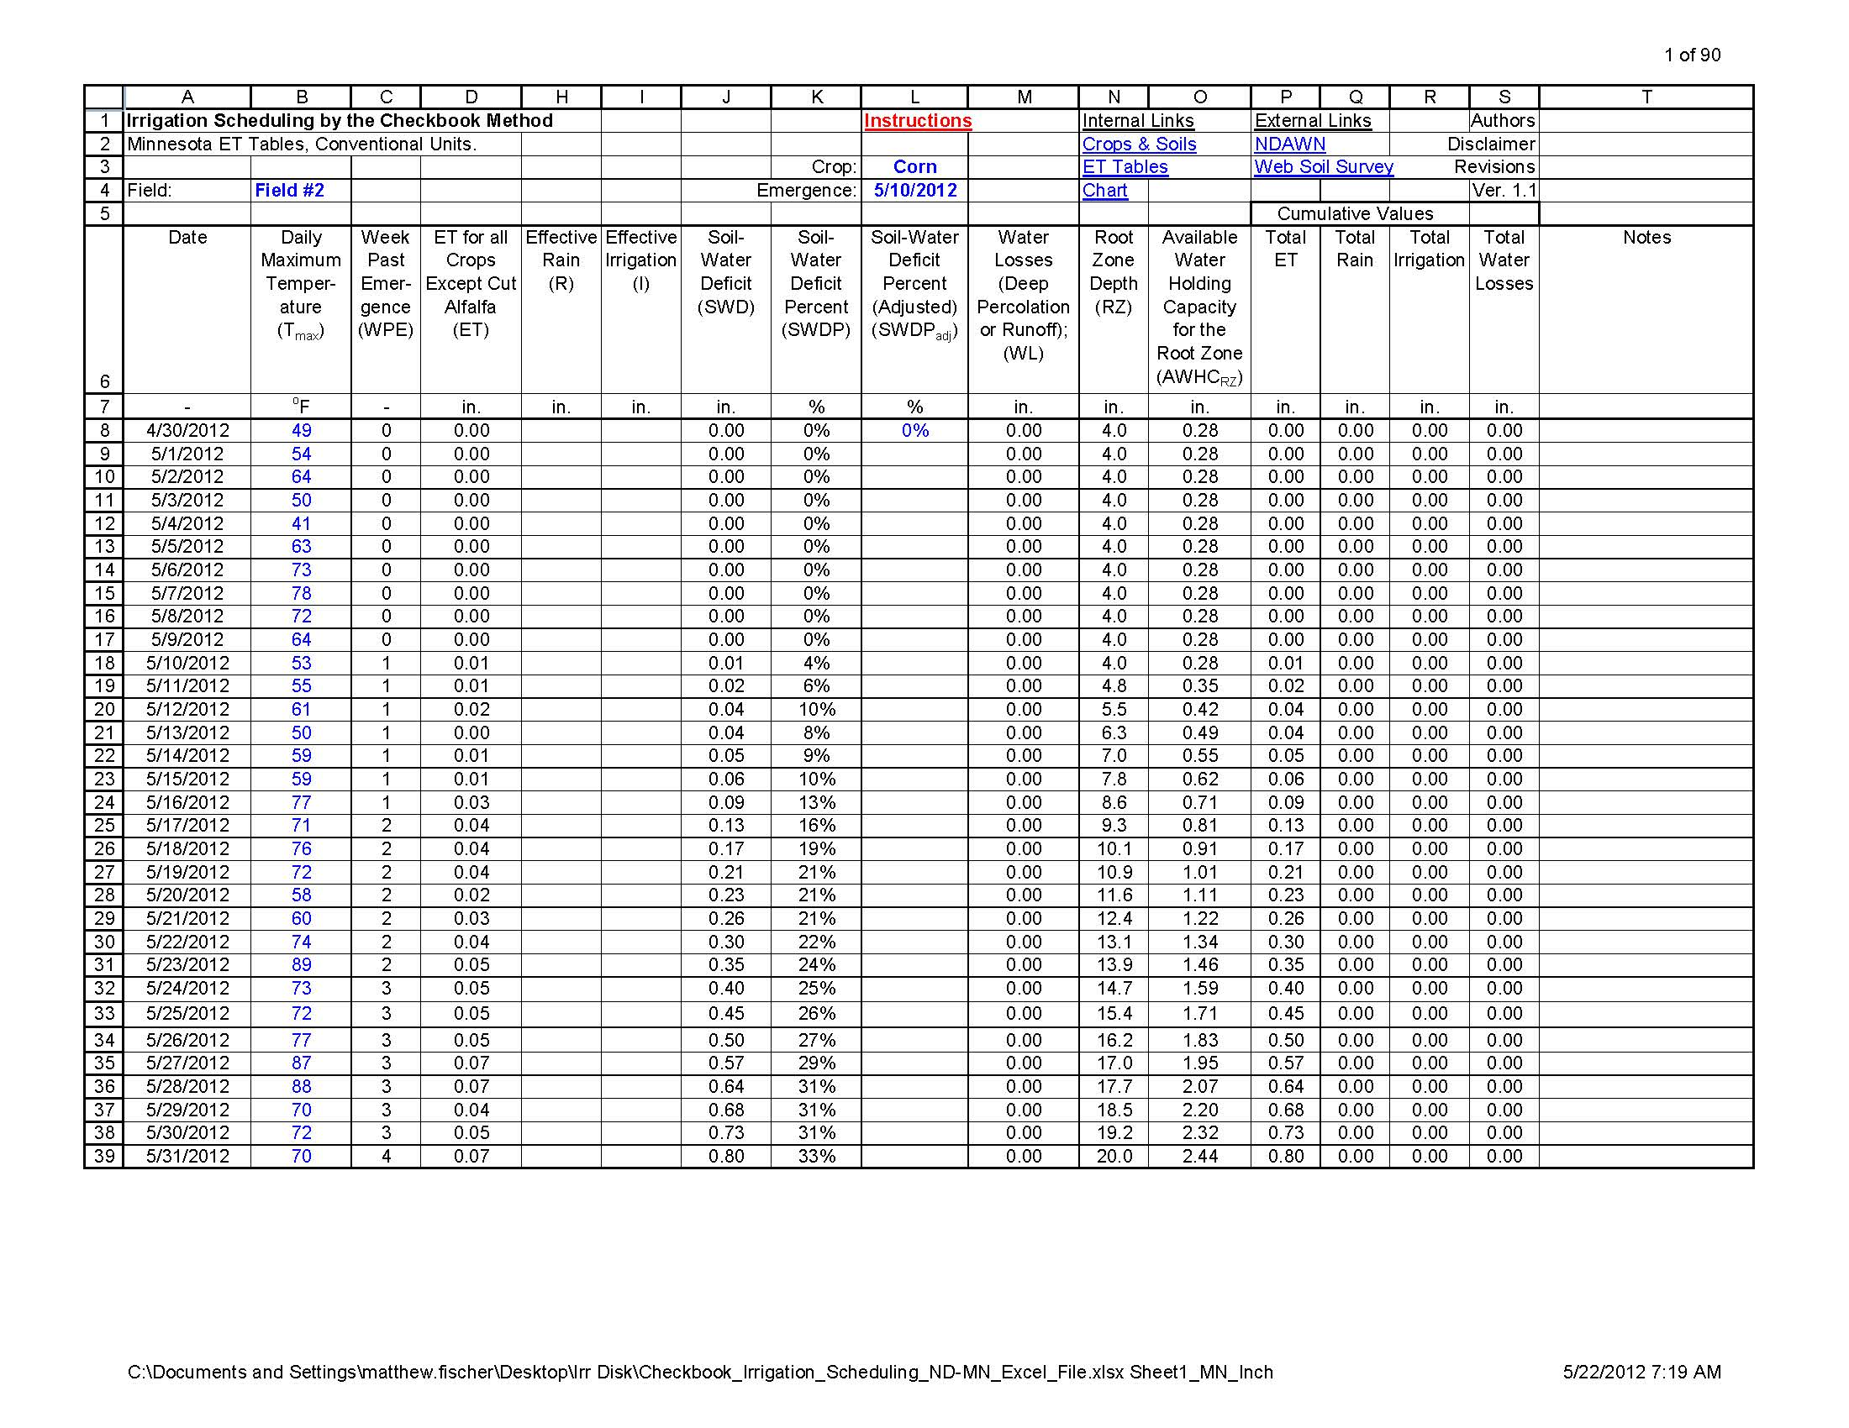

Slide 41
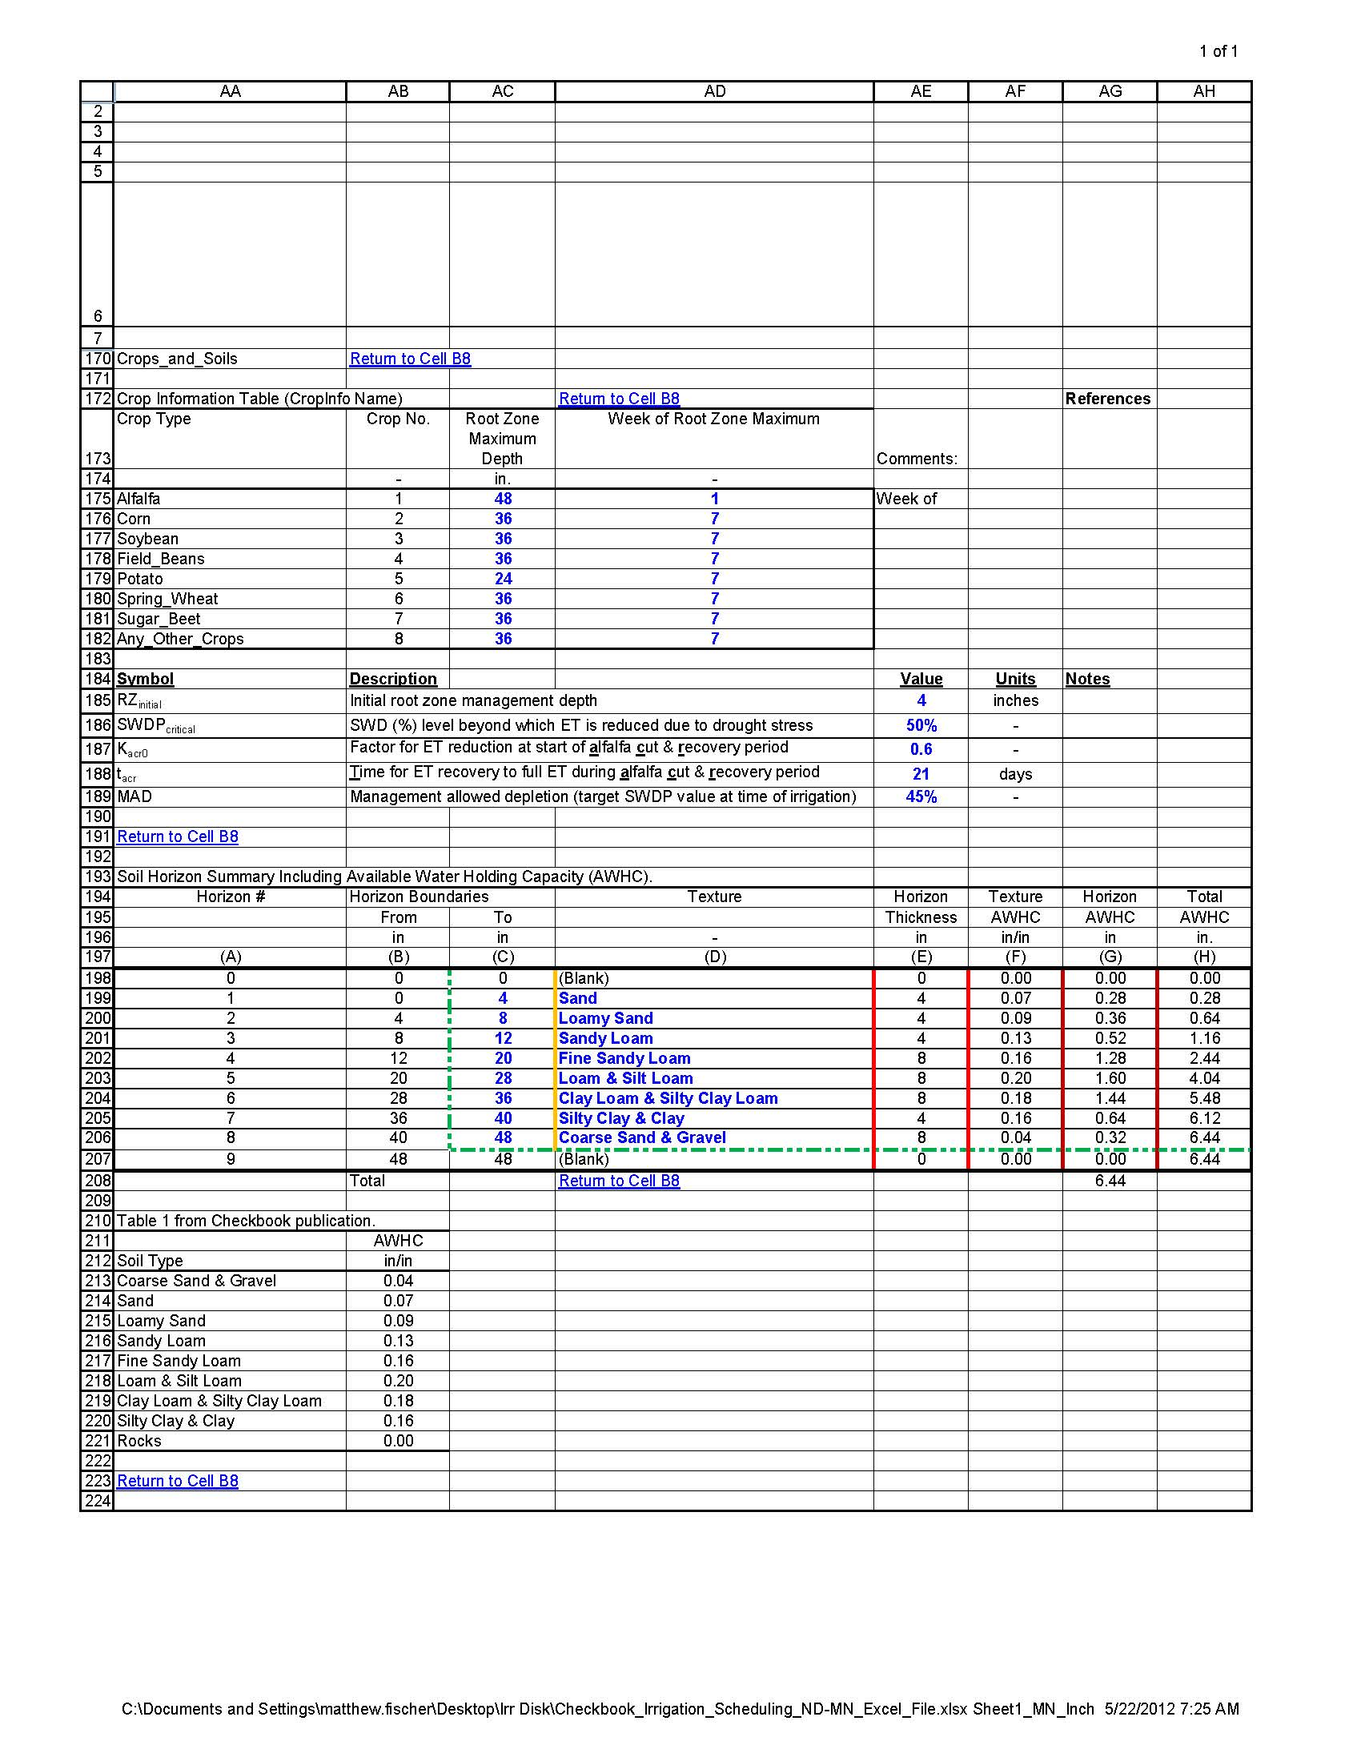

Slide 43
Table 7 Guidelines for soil moisture depletion allowances for irrigation management.
Crop | Seedling | Vegetative | Critical Period | Maturing
Corn | 50% | 50% to 70% | 30% to 50% | 60% to 70%
Soybeans | 50% | 60% to 70% | 40% to 50% | 60% to 70%
Potatoes | 50% | 40% to 60% | 20% to 40% | 60%
Small Grain | 50% | 60% to 70% | 40% to 50% | 60% to 70%
Field Beans | 50% | 50% to 70% | 30% to 50% | 60% to 70%
Sorghum | 50% to 60% | 60% to 70% | 40% to 60% | 60% to 70%
Alfalfa | 30% to 40% | 40% to 60% |  | 60%

Slide 44
Irrigation Scheduling Worksheet
Fill in Temperature data up to date
Fill in Rainfall and Irrigation Amounts
Enter a beginning Soil Water Deficit and enter estimates whenever you take them
Recommend weekly, at least every other week
Enter forecast to predict future crop water needs and replace with actual data when you have it
Recommend entering data once a week on the same day
Unless there is a significant change from what the forecast was

Slide 46
Estimating Soil Moisture by Feel and Appearance

Slide 47
Estimating Soil Moisture Percentages
Obtain a soil sample at the selected depth using a probe, auger or shovel
Squeeze the soil sample firmly in your hand several times to form an irregularly shaped “ball”
Squeeze the soil sample out your hand between thumb and forefinger to form a ribbon
Observe the soil texture, ability to form a ribbon, firmness and surface roughness of the ball, water glistening, loose soil particles, soil/water staining on fingers, and soil color
Compare observations with the photographs and/or charts to estimate percent of water availability and the amount depleted below field capacity

Slide 48
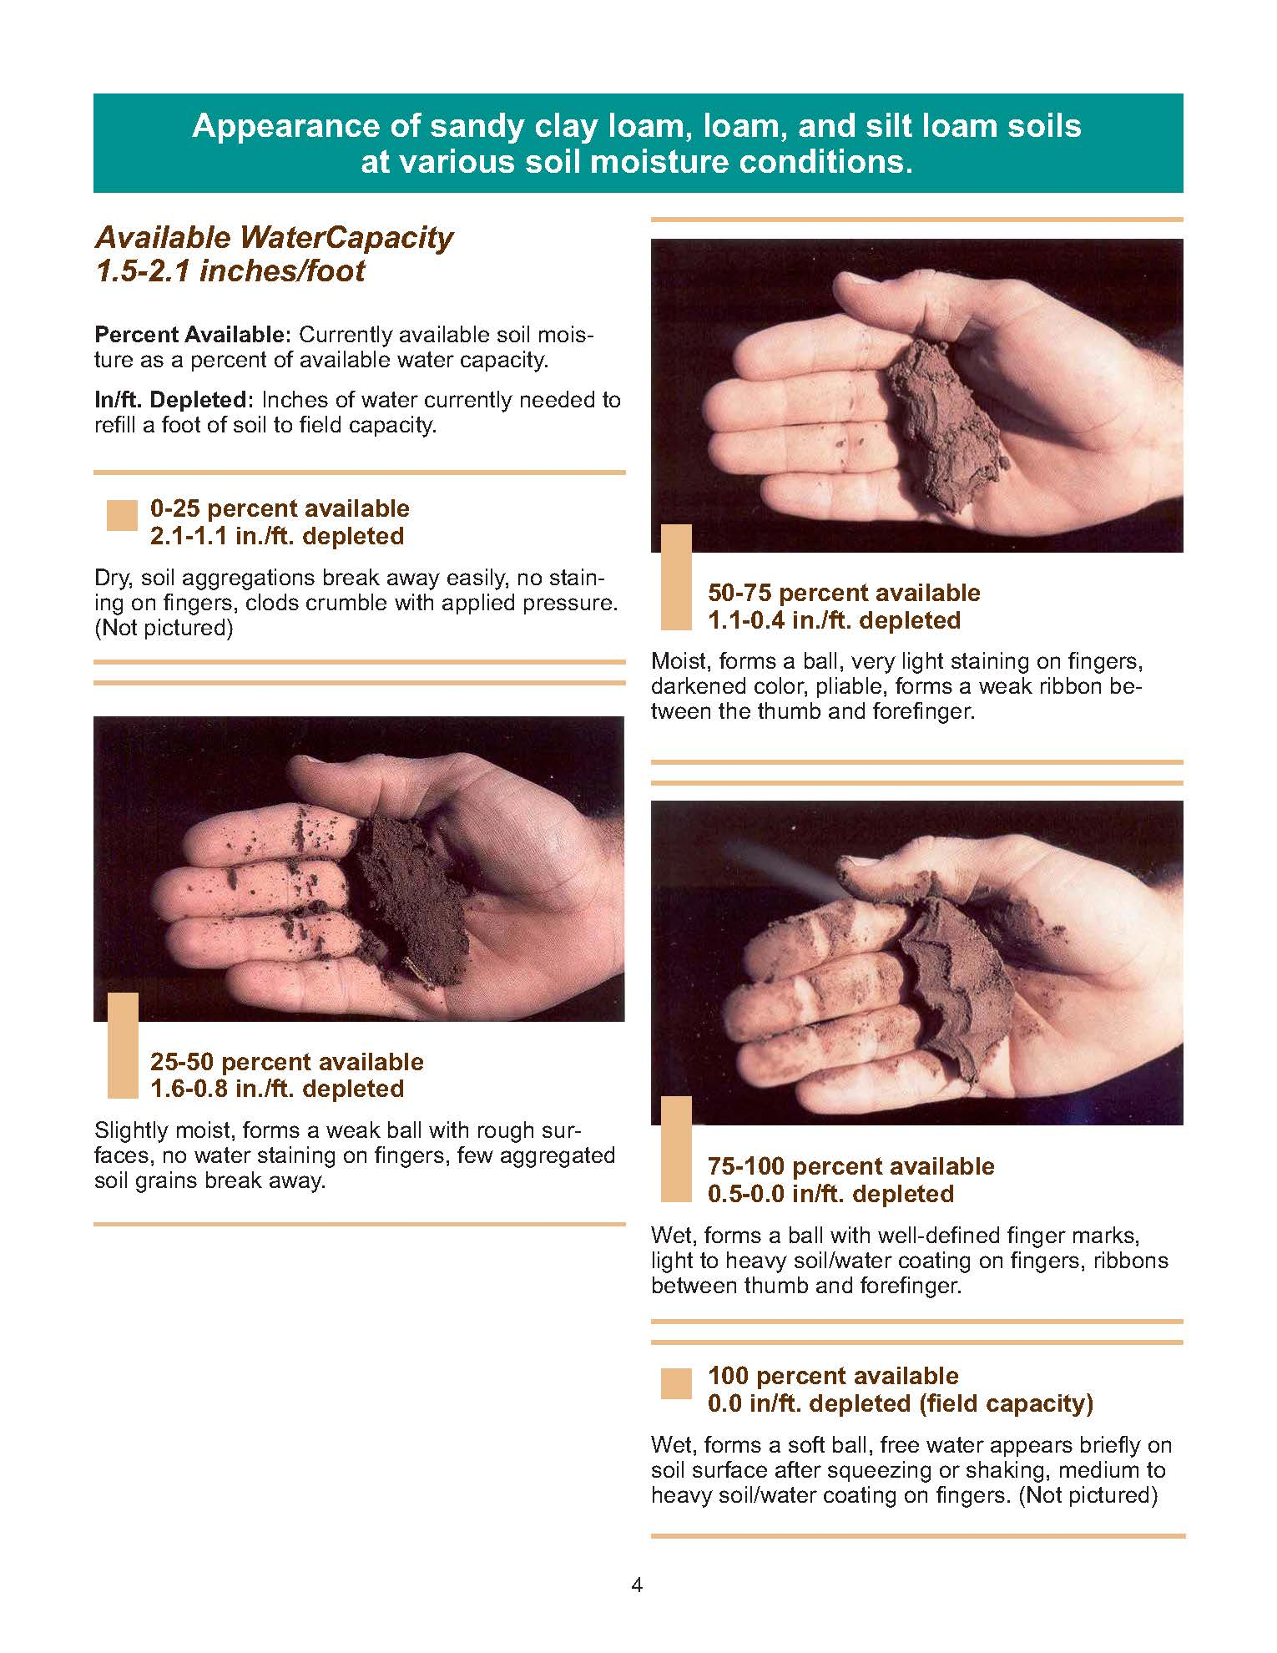
Notice this estimates by percent available & in the irrigation worksheet you will enter percent depleted
60% available = 40% depleted

Slide 49
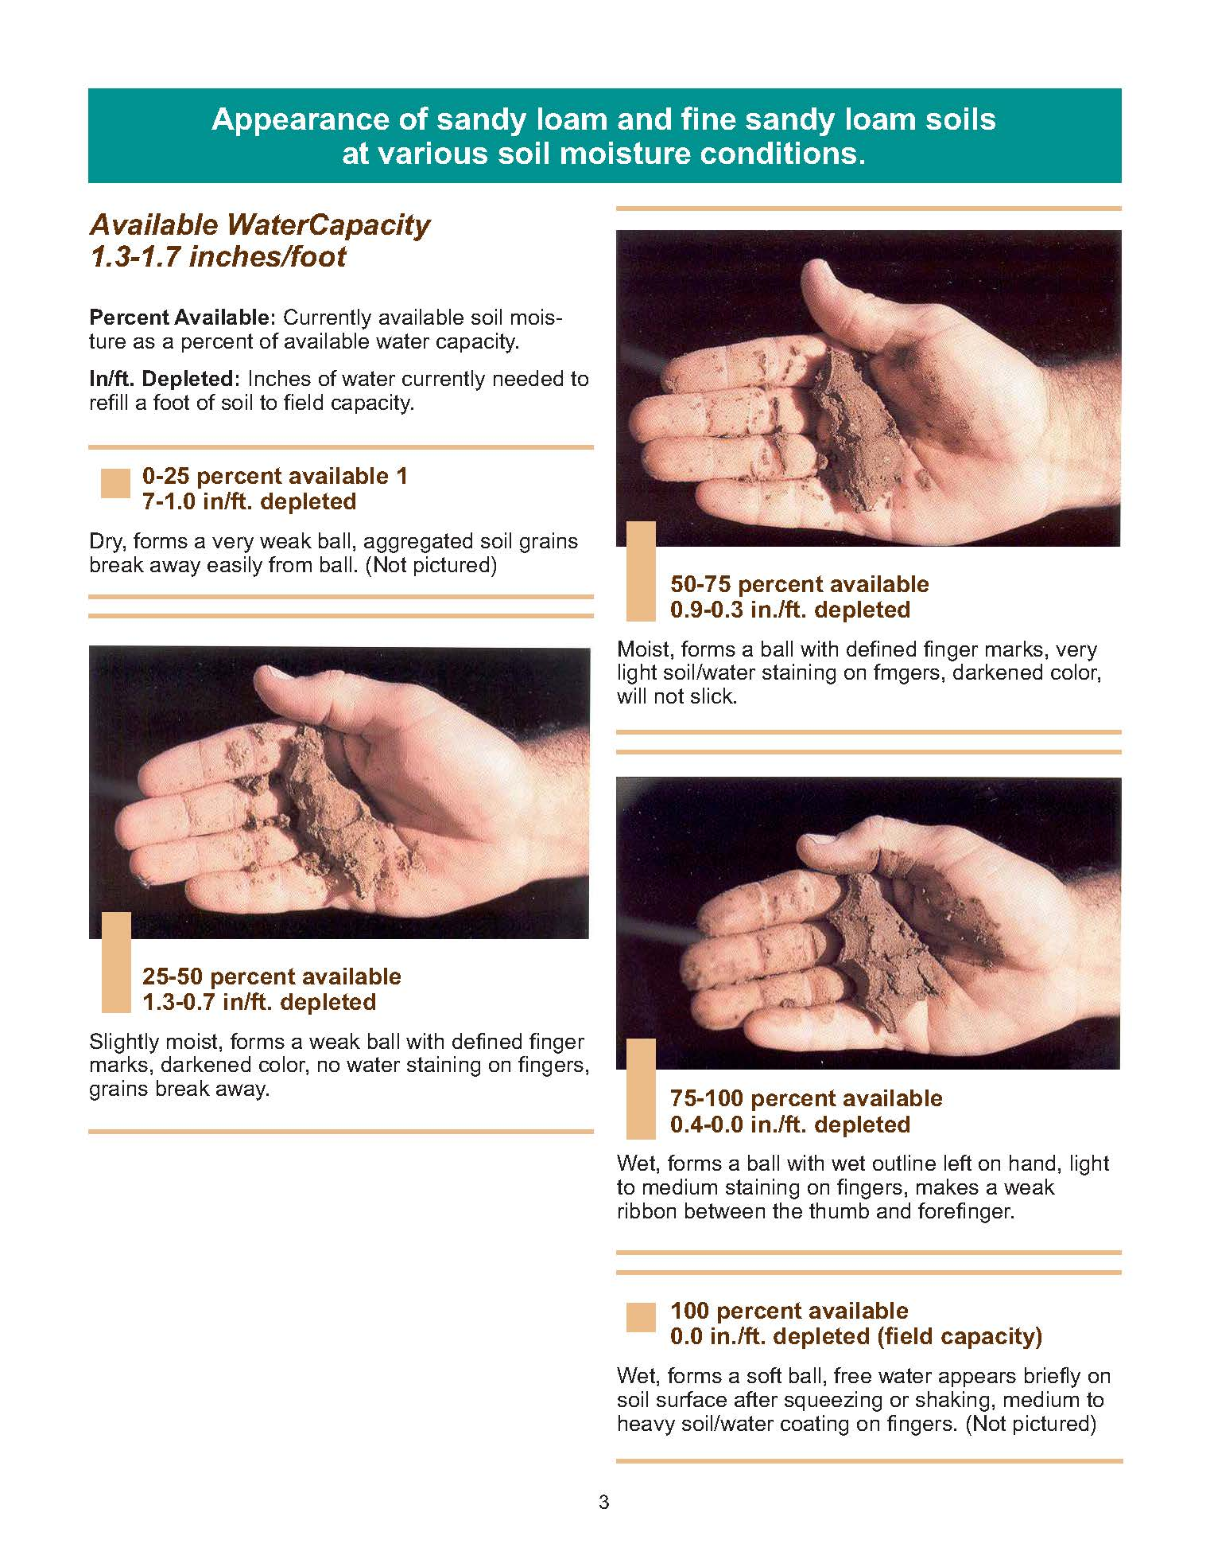

Slide 51
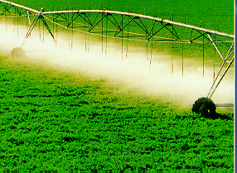
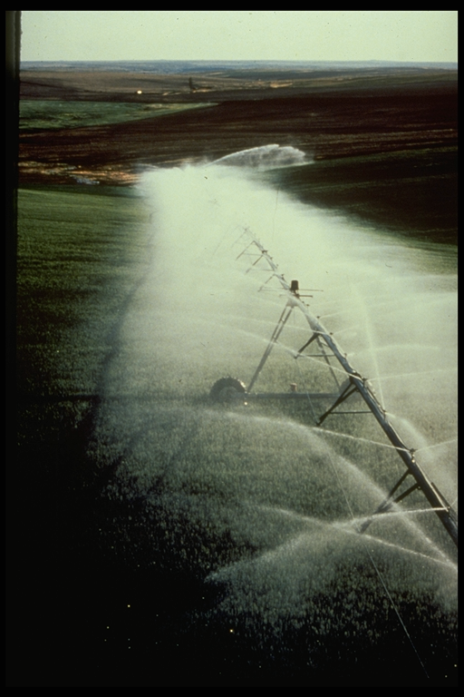
Know Your Center Pivot!!!
Net Application Depth is a function of GPM, Acres, Speed and application efficiency and uniformity
Outer End Has the Greatest Application Rates and Impact on Runoff
Water Distribution Uniformity: 80 – 90% CU (Co-efficient of Uniformity)
Application Efficiency Potential 80 to 90+%

Slide 52
Center Pivot Rotation Time
R_{t} - Rotation Time of Pivot (hours)
Area - Acres Covered By Pivot
Depth - Inches of Water that Infiltrate into the Soil
Flow Rate - Gallons per Minute to Pivot
Eff_{A} - Application Efficiency of Center Pivot

Slide 53
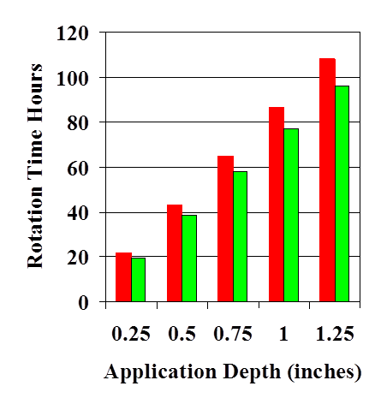
Know your Center Pivot!! Rotation Time and Water Application Depth - Example -
Area = 130 Acres
Eff_{A} = 85%
Flow Rate = 800 gpm
Flow Rate = 900 gpm

Slide 54
Center Pivot Distribution Uniformity – KI01.
Center Pivot Distribution Uniformity – KI01.
Center Pivot Distribution - KI01; June 9, 1999
0.80
0.70
CU = 90%
0.60
0.50
Depth (in.)
0.40
0.30
0.20
0.10
0.00
600
700
800
900
1000
1100
1200
1300
1400
Radius (ft)

Slide 55
Irrigation Scheduling – Daily Decisions
When to start irrigating?
How much to apply?
When to stop irrigating?
How fast to run the pivot?
How uniform does the pivot apply water?
How much water does & is the soil holding/
How much water did the crop use today/last week?

Slide 56
Water Management During Early Greenup
Allow soil water level to dry to 40-50% available water capacity before irrigating (50-60% soil water depletion)
Assumes good soil water at emergence
If you need to irrigate in vegetative growth period, apply only 50-75% of the deficit so as to leave room for unexpected rainfall to minimize leaching potential of nitrates in the soil

Slide 57
Water Management During Flowering and Fruit Development
Maintain a little wetter than in vegetative stage (20-40% soil water depletion) so ET demands are more easily met
Growth period is most sensitive to water stress
Avoid light irrigation events – refill soil

Slide 58
Table 7 Guidelines for soil moisture depletion allowances for irrigation management.
Crop | Seedling | Vegetative | Critical Period | Maturing
Corn | 50% | 50% to 70% | 30% to 50% | 60% to 70%
Soybeans | 50% | 60% to 70% | 40% to 50% | 60% to 70%
Potatoes | 50% | 40% to 60% | 20% to 40% | 60%
Small Grain | 50% | 60% to 70% | 40% to 50% | 60% to 70%
Field Beans | 50% | 50% to 70% | 30% to 50% | 60% to 70%
Sorghum | 50% to 60% | 60% to 70% | 40% to 60% | 60% to 70%
Alfalfa | 30% to 40% | 40% to 60% |  | 60%

Slide 59
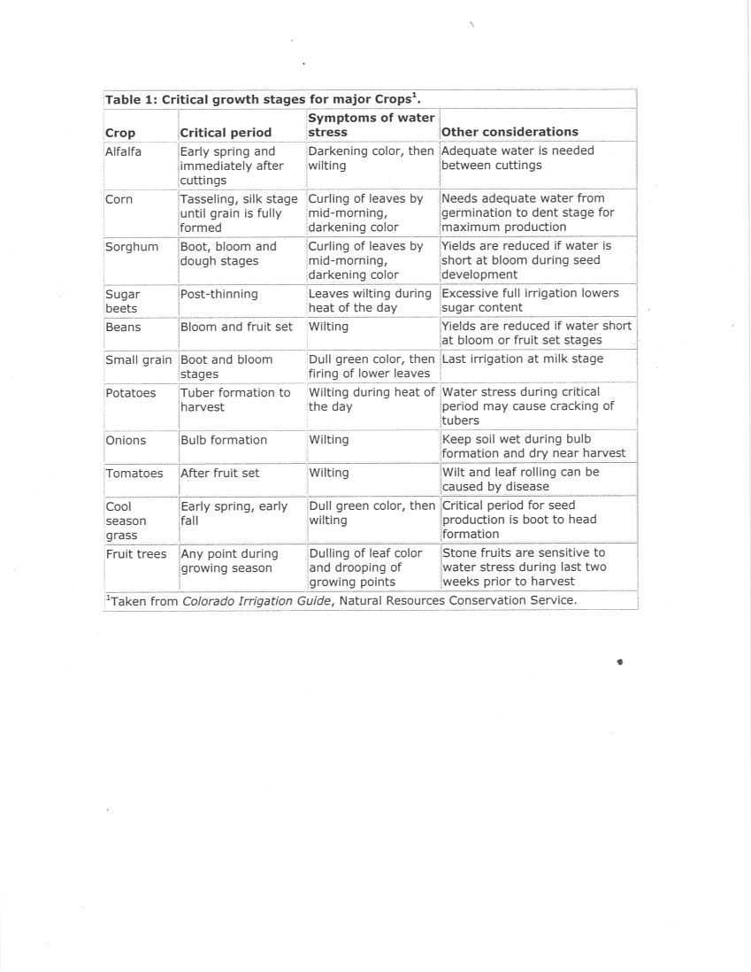

Slide 60
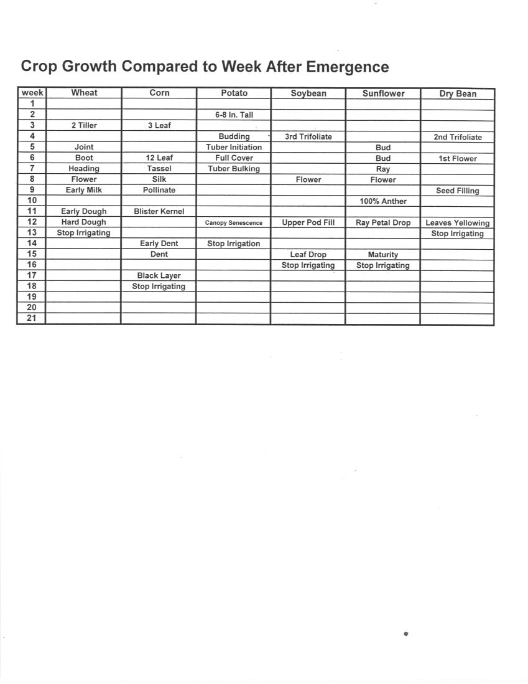

Slide 61
Corn Water Use to Maturity Projections
Stage of Days to Inches of ET
Plant Growth Maturity to Maturity
Blister 45 – 50 7.0 – 7.5
Milk 38 – 42 4.8 – 5.3
Early Dent 30 – 35 3.2 – 3.6
Full Dent 23 – 27 2.1 – 2.4
½ Milk Line 12 – 14 0.9 – 1.2

Slide 62
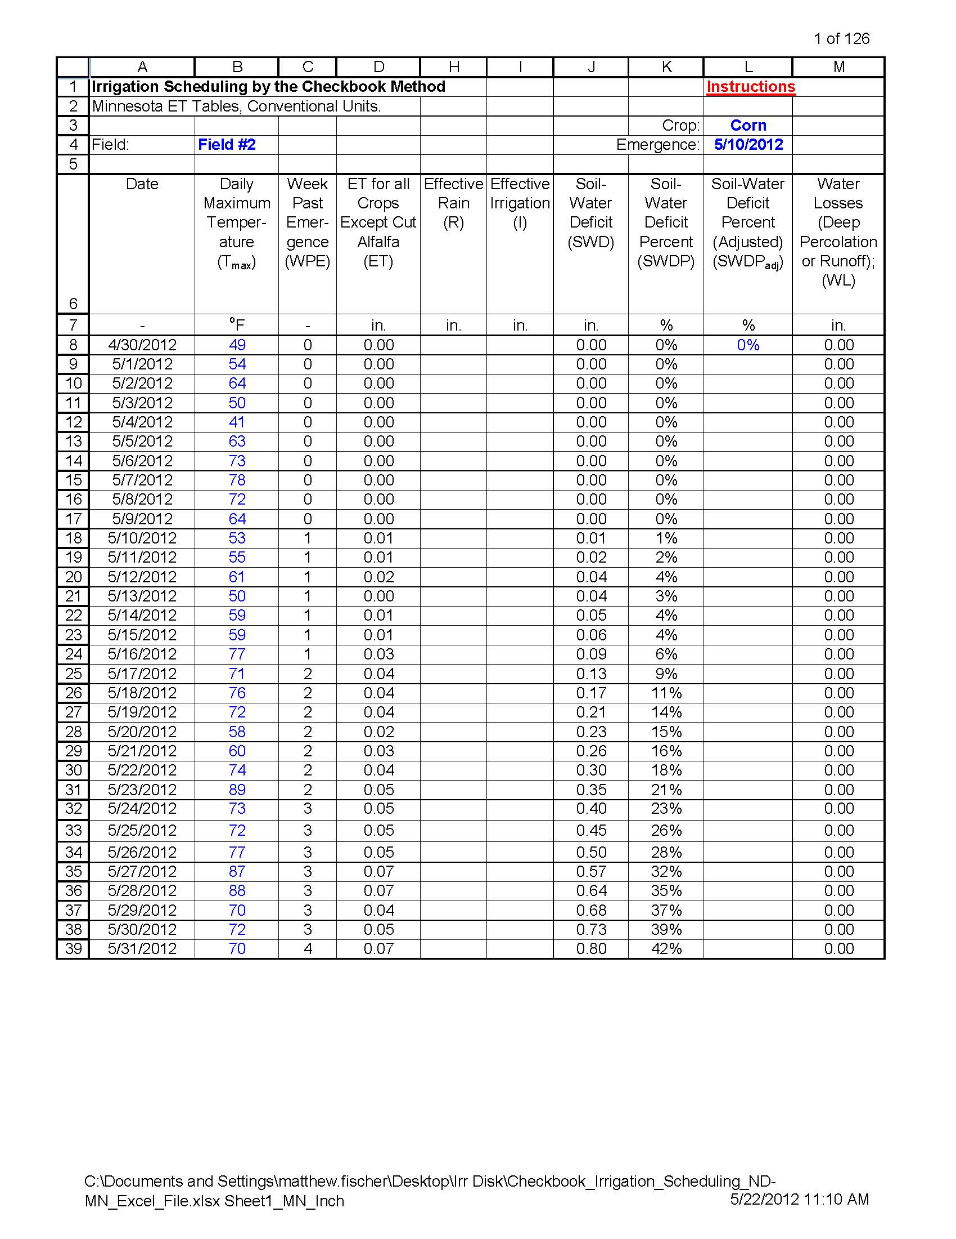

Slide 63
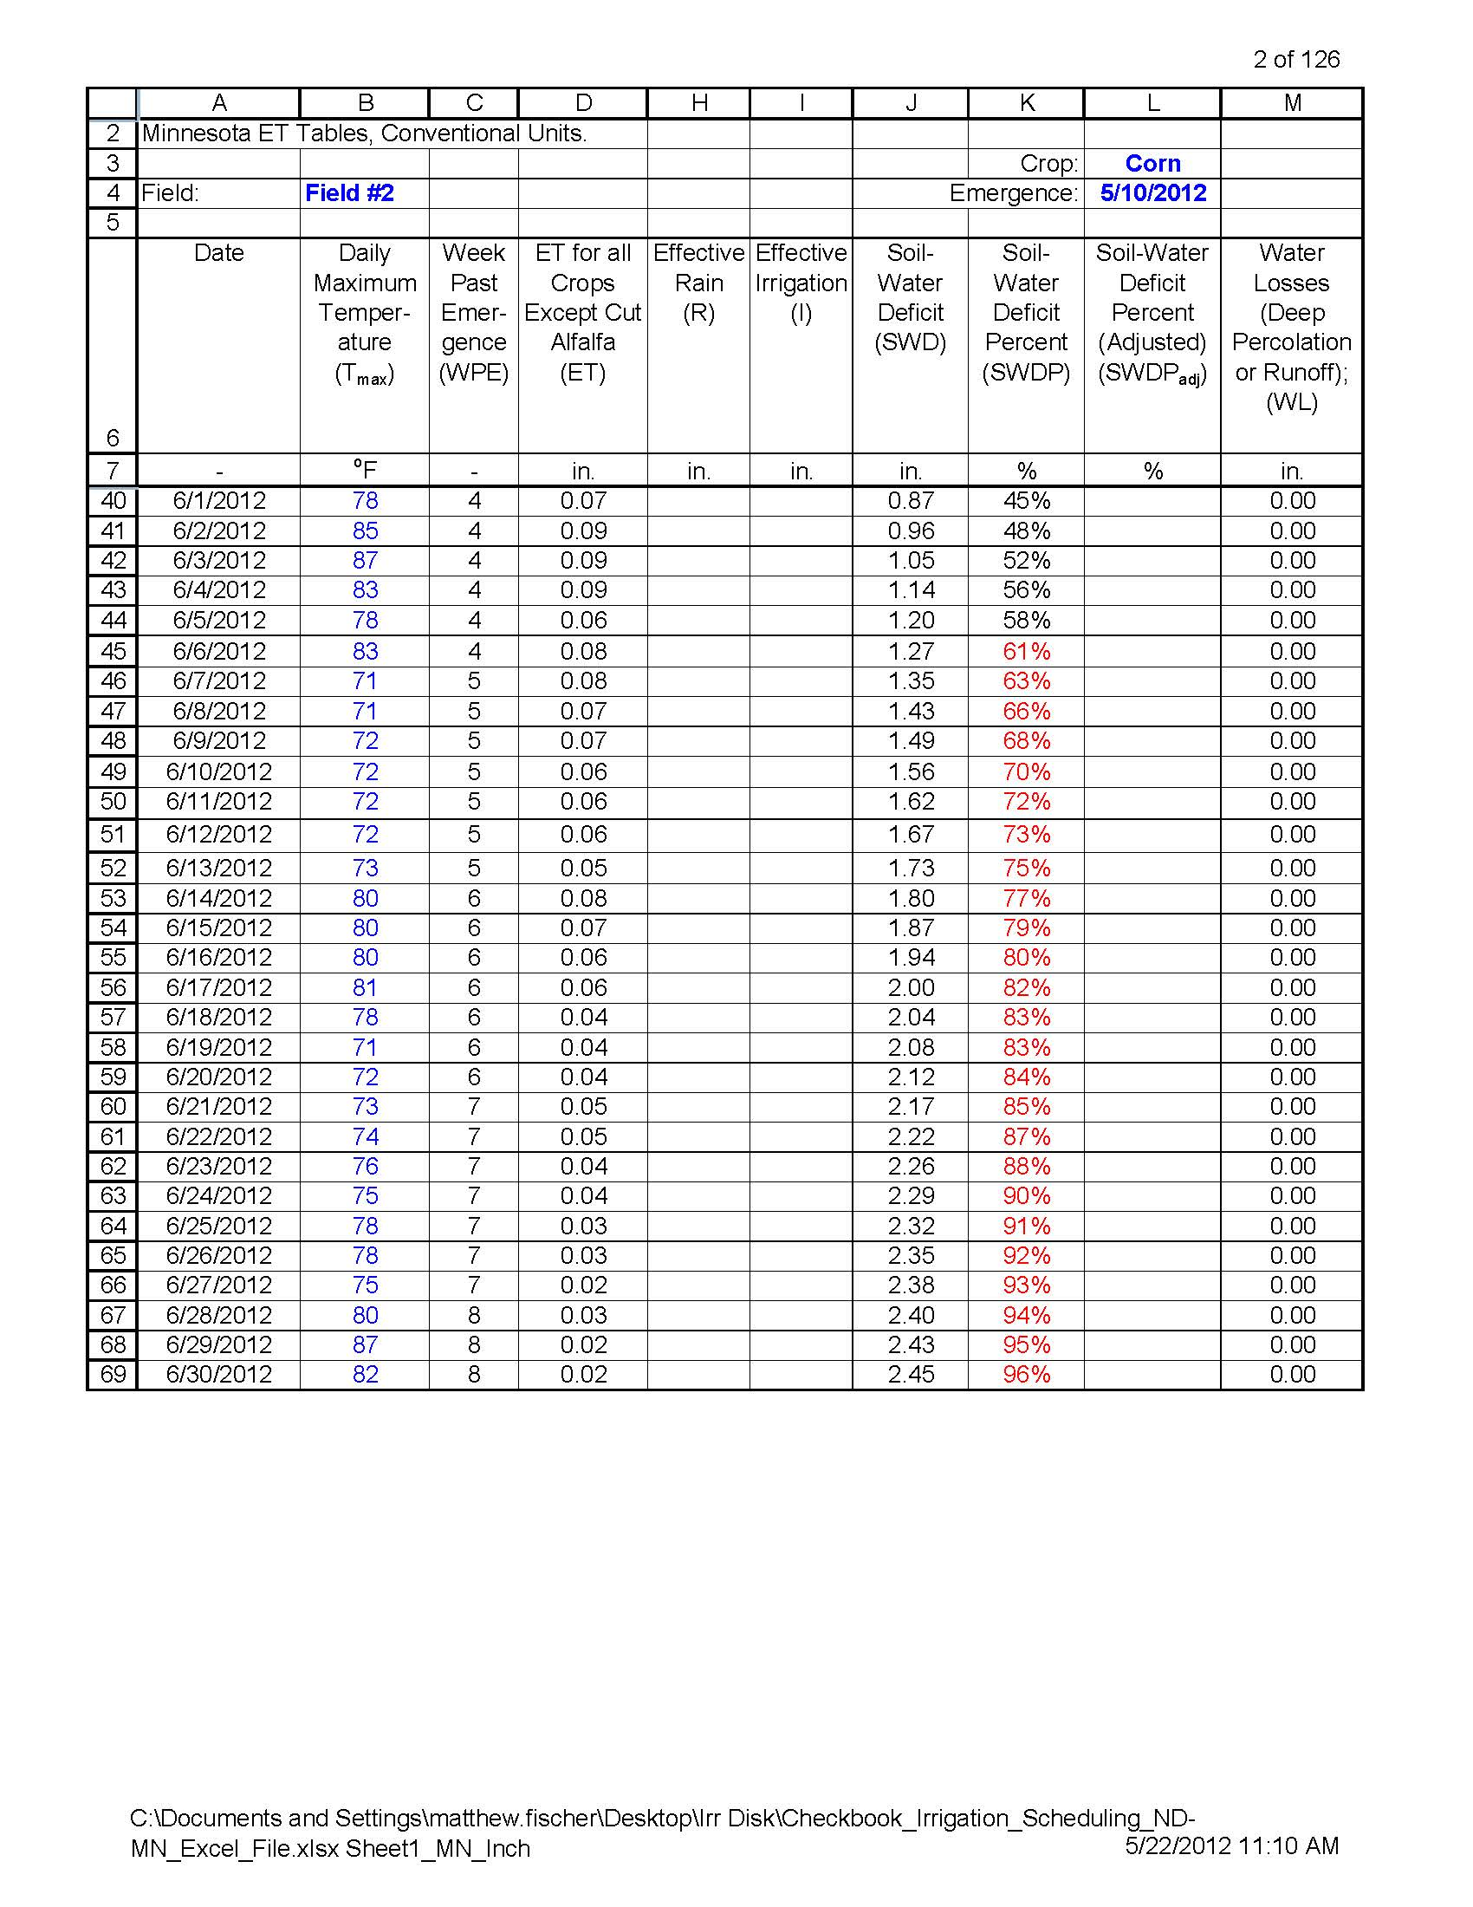

Slide 64
Creating Charts
On the top of the worksheet click on Chart
You will have to scroll to the right and down
You will need to include this with year end report for EQIP
Also include print off of worksheet (make sure to select only pages needed “1-5” or it will print 90 pages of blank columns)

Slide 65
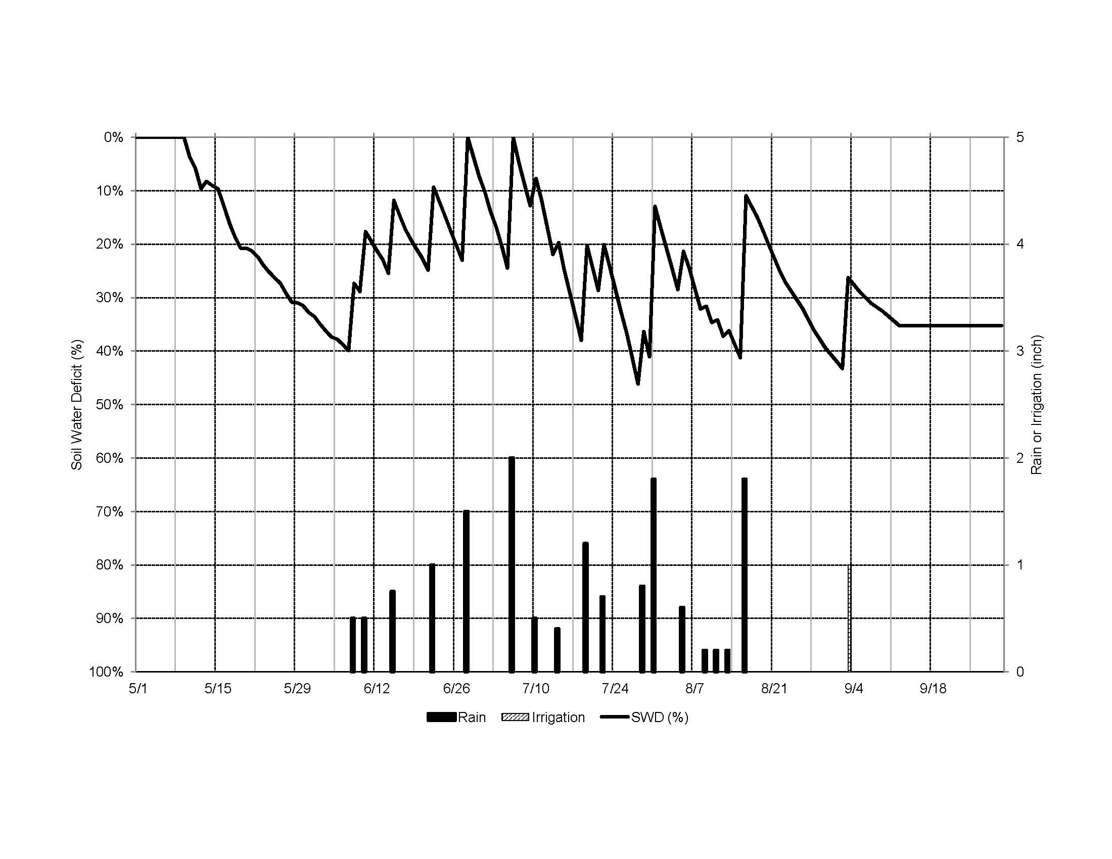

Slide 66
Have a Successful 2012 Season!
Special Thanks to Arnold Rethemeier from East Ottertail SWCD

Slide 67
Pope SWCD and the USDA prohibits discrimination in all of their programs and activities on the basis of race, color, national origin, sex, religion, age disability, political beliefs, sexual orientation, and marital or family status.

